Slide 1


Slide 2
Presentation
Introdution Mivena
Mivena products
Duration technology
Strawberry
Strawberry open field production
  Plant production
  Waitingbed plants
  Fruit production

Slide 3
Strawberry substate
  Trayplants
  Table grown production
Raspberry
Blueberry
Red currant
Blackberries
Black currant
Mivena trials

Slide 4
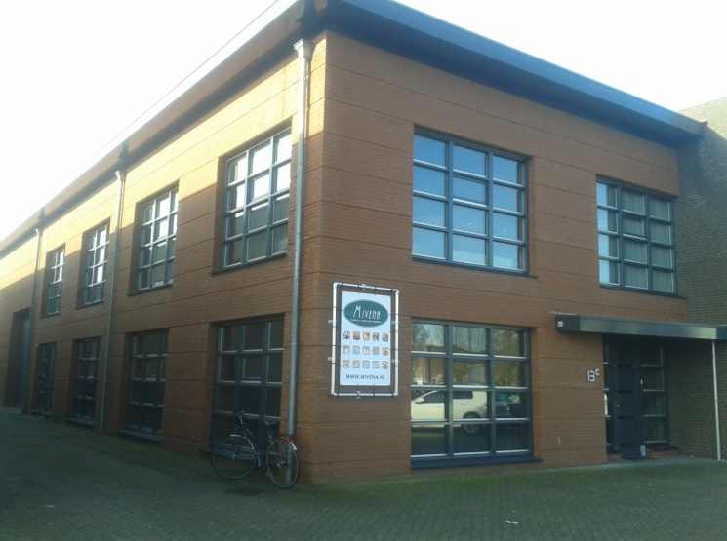
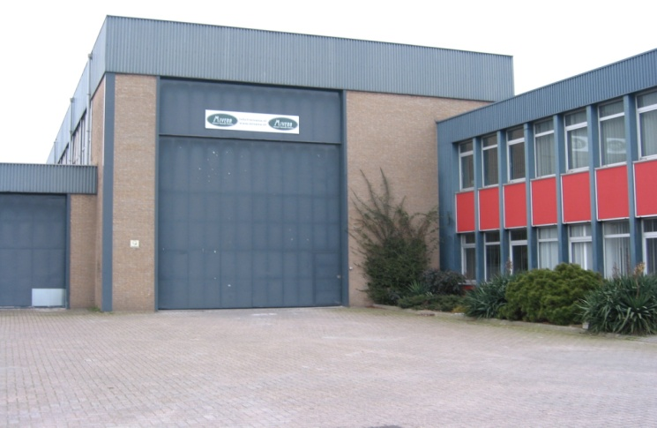
Locations
Mivena Office
Sprangseweg 13c
5144 NV Waalwijk
The Netherlands
Mivena Factory
Ankerkade 154
6222 NM Maastricht
The Netherlands

Slide 5

Mission statement Mivena B.V.
Mivena develops specialty fertilizers and or technologies to be used in various food/turf and horticultural crops to enable the producers to minimise the pollution and the effect on the environment by fertilizers.
We will produce, by using these technologies, minimal the same or more yield versus present systems used.

Slide 6
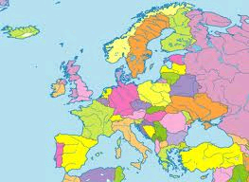
Mivena is active in:
The Netherlands
Belgium
Luxemburg
Germany
United Kingdom
Ireland
France
Spain
Portugal
Austria
Switzerland
Ethiopia
Poland
Italy
Estonia
Bulgaria
Romania
Turkey
Greece
Czech Republic
Kenia
UAE
Finland
Tanzania

Slide 7


Slide 8

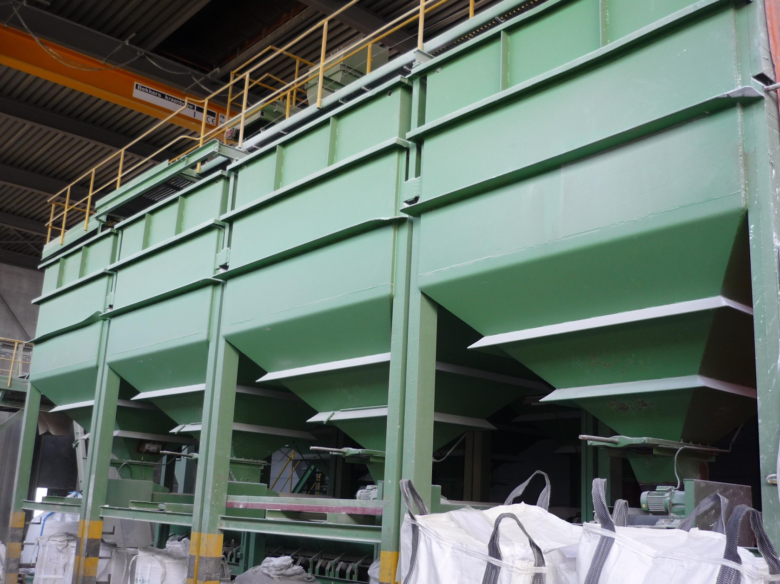
Mivena production Maastricht

Slide 9
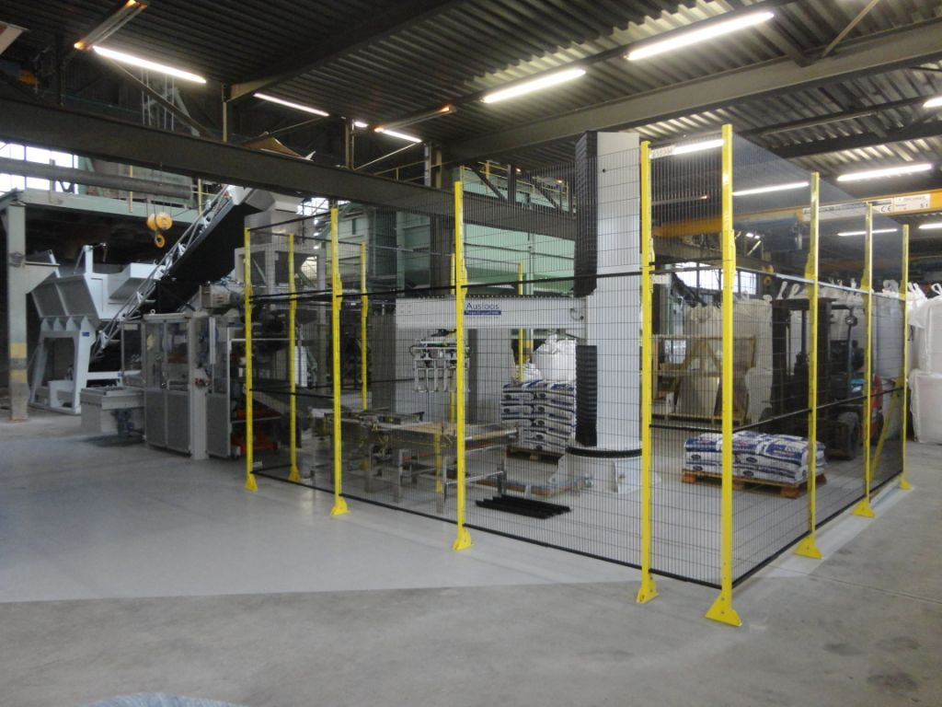

Slide 10
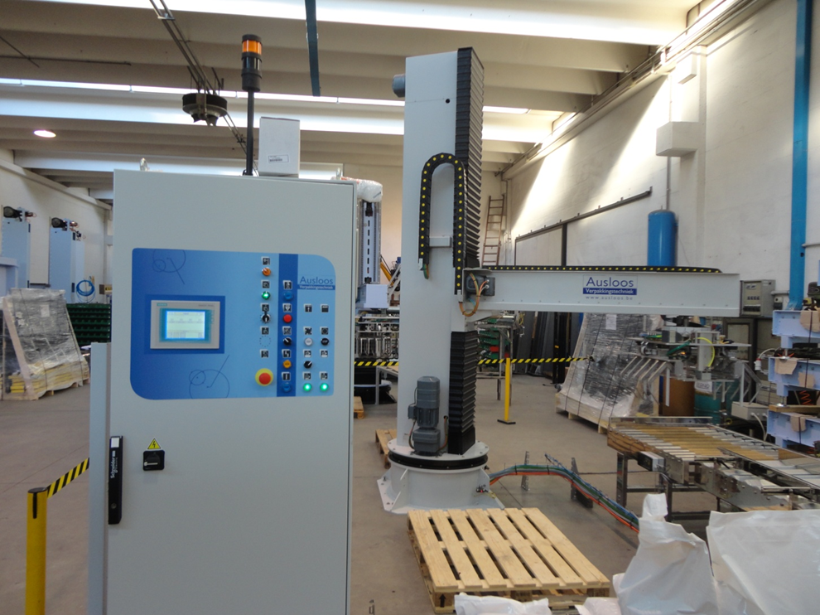


Slide 12
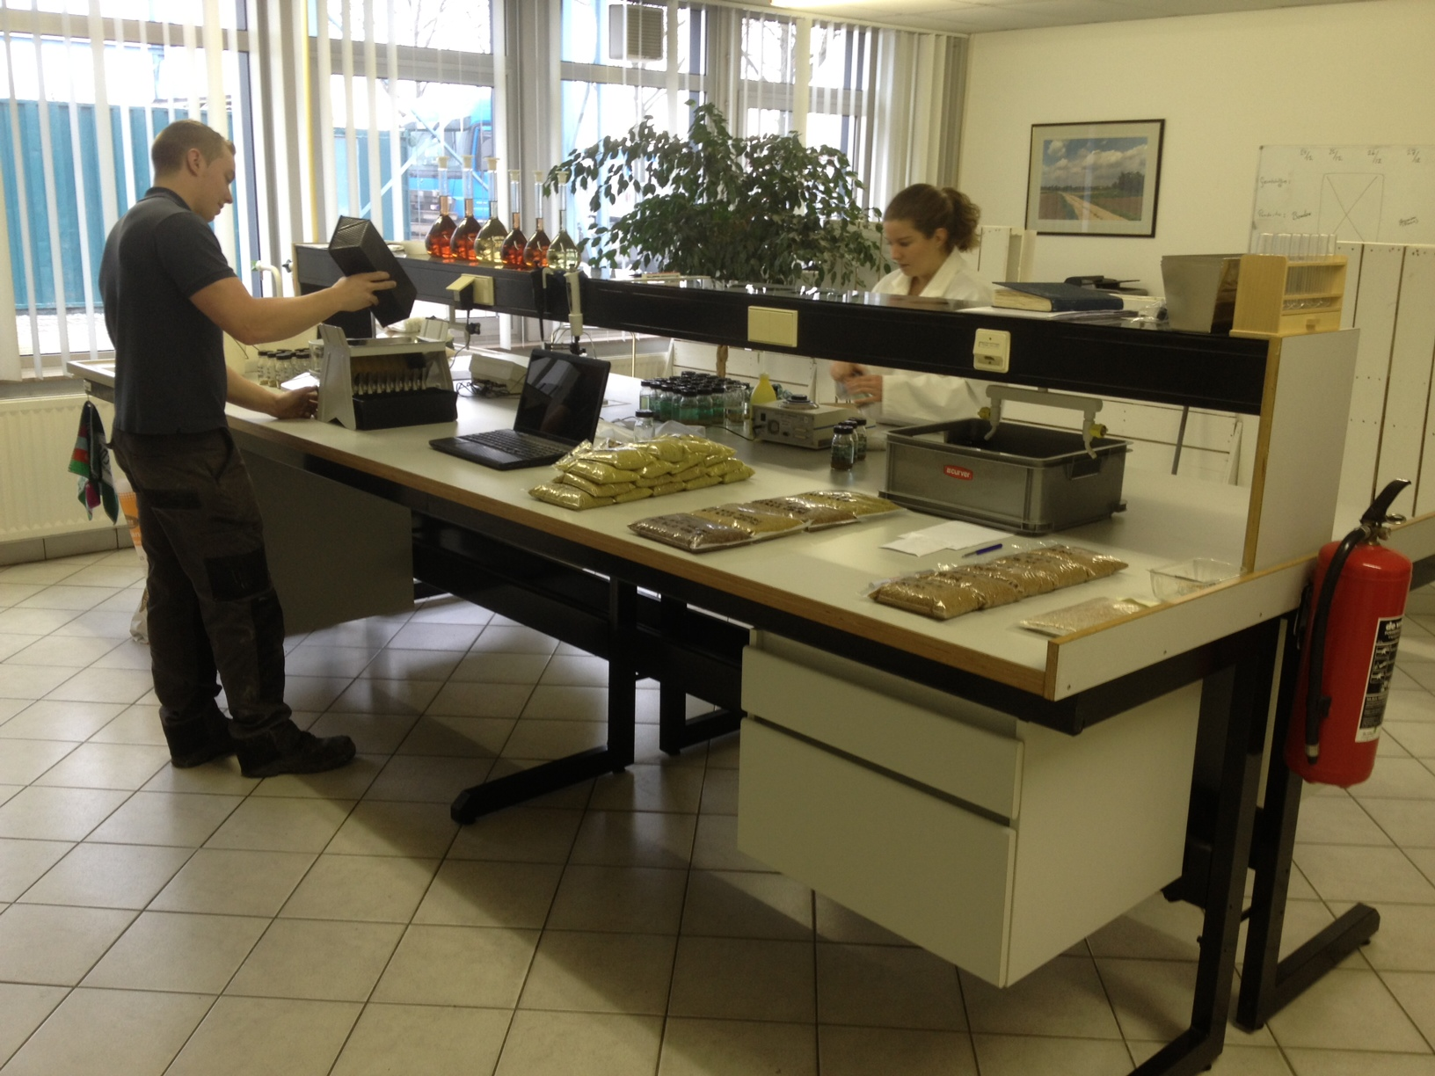

Slide 13
Review Technologies Mivena
2016

Slide 14


Slide 15

Duration Technology
Latest development in Resin coating technic
Patent by Mivena, unice in Europe
No metals in the coating
More constant thiknis of coating
Not a big relaese in the start, slow starter!

Slide 16
CRF (Controlled Release Fertilizer)
Release only influenced by Temperature
Water Soluble Fertilizers
High Quality “free-flowing” products
Slow Release Fertilizers
Release influenced by Temperature, Bacteria, Water, etc
Others
Traces etc

Slide 17
Controlled Release
NPK plus minors, like 16+6+12+2+
NPK, like 19+6+12
NP, like 10+49+0
N, like 43+0+0
K, like 0+0+46

Slide 18
CRF :Consistent Quality =
Optimum Performance
Experience production
Testing raw materials, including close working together with suppliers
Testing release of products produced
Testing (also prior to blending)
Testing of the End products
Focus : release of the products

Slide 19
Horticote®Plus CRF
16+6+11+2MgO+Trace elements
Longevity 6M
Coated:
N ; 100%
P ; 100%
K ; 100%
Traces : 100%
Plus MgO which is also coated

Slide 20
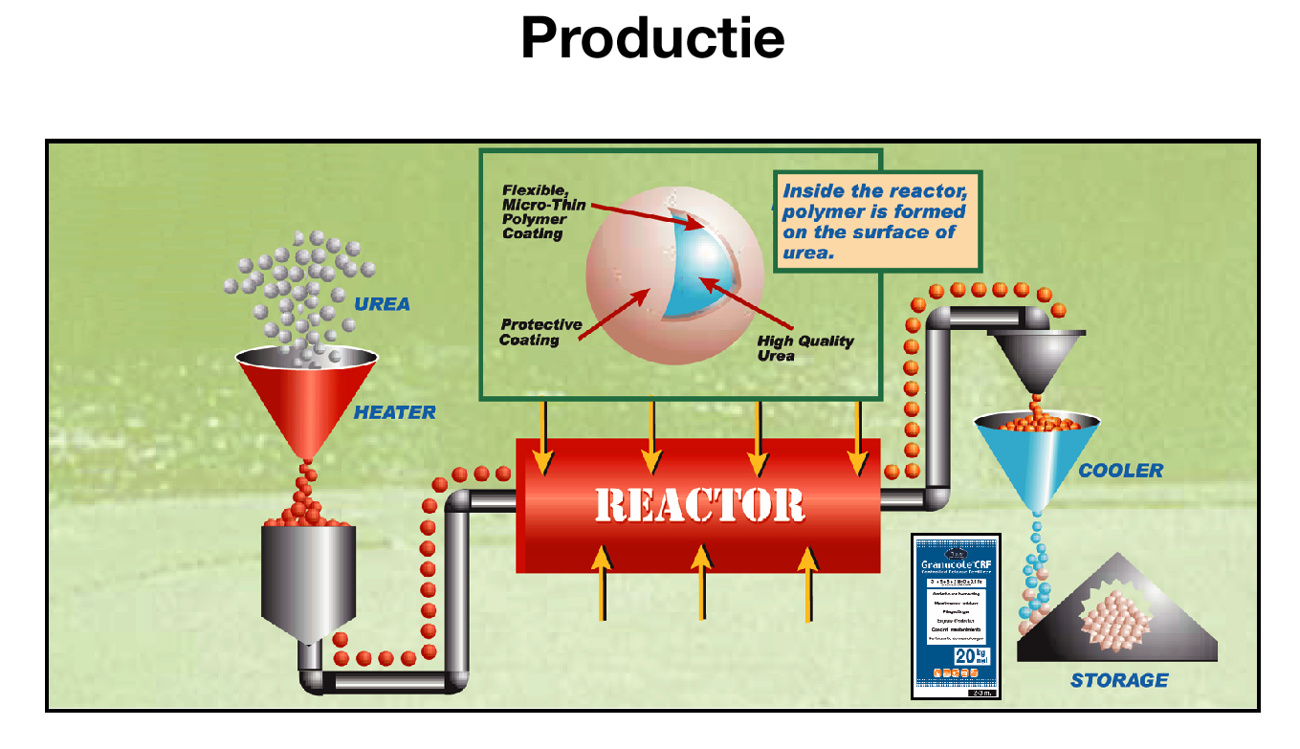

Slide 21
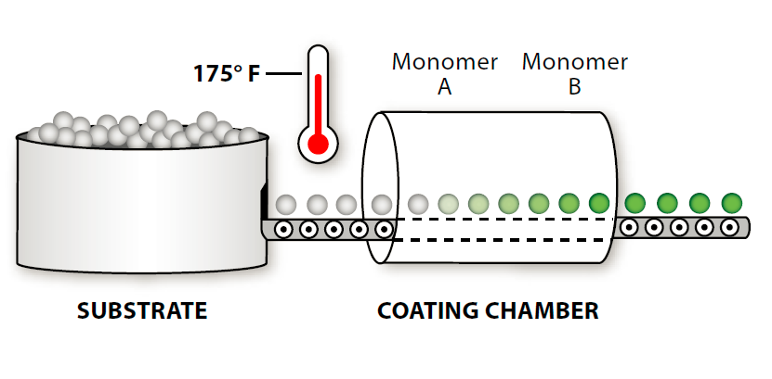

Fluid bed coater

Slide 22
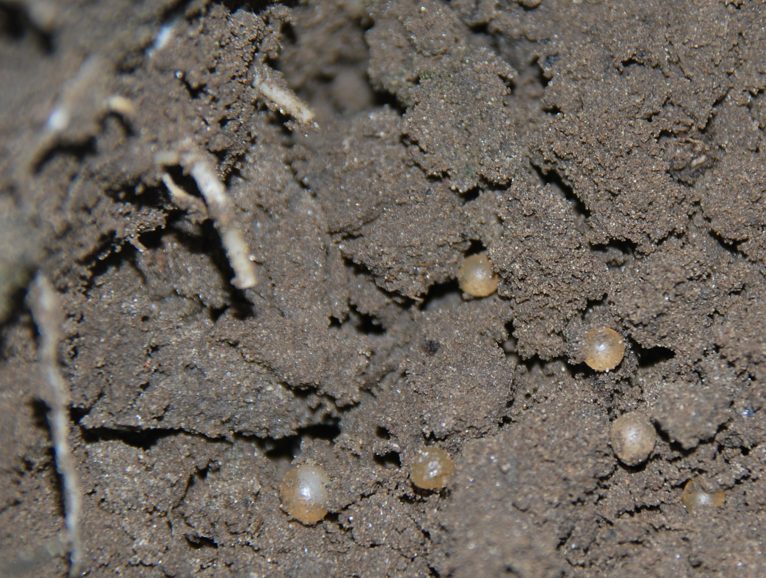

Slide 23
Controlled Release Principle Horti- Cote® CRF Plus
Controlled Release Principle Field- Cote® CRF

Slide 24

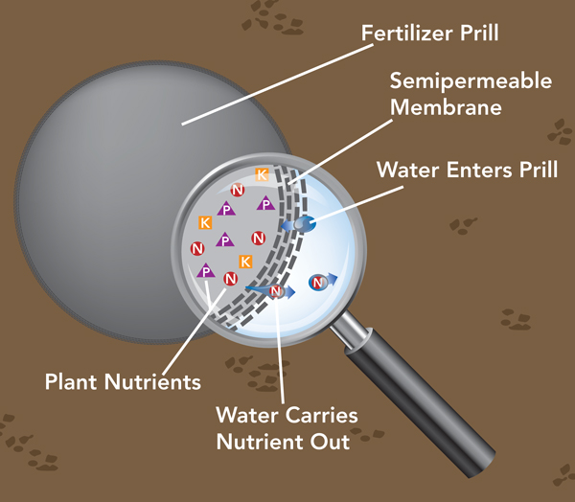
Coating methodes

Slide 25
Granucote®CRF, Horti- Cote®CRF Plus, Field- Cote®CRF

Slide 26
Practical information CRF

Slide 27
Influentual Outside Factors on CRF and SRF Products
Factors/ Fertilizer Resin Sulpher Slow Release Nitrate inheb. Agricult. Coated Coated as MU, IBDU etc. mixed in fert. Fertilizer
Temperature yes yes yes yes yes
Water no yes yes yes yes
Ph no no/yes yes yes yes
Bacterial activity no yes yes yes yes
Soil type no no yes yes yes
By resin coated fertilizers is only temperature influensing the release.
There is needed water to transport the nutrients from granual to roots.

Slide 28
KAS
Entec
Floranid
Horti-Cote
Field
-
Cote
(Novatec)
Permanent
Plus
NO
3
¯
50
%
40%
13%
NH
4
+
50
%
60%
50% 5,6%
(
NH2)
2
CO
IBDU / MU
37%
Organisch
Resin coated
80%
-(NH2)2 CO 46%
-NH4 26% 10%
-NO3 28% 4,4,%

Slide 29
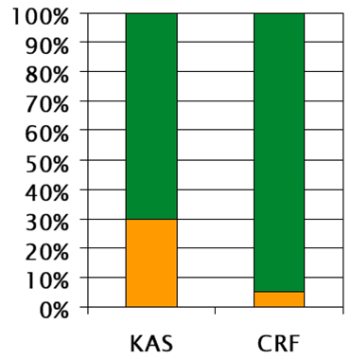


efficiency crf
-Orange: leached
-Green: plant uptake

Slide 30
Benefits CRF for environment
Uses less kg fertilizer / ha to produce the same or more yield
Less pollution
More safe environment
Less labour
Easy to use
Special analyses / longevity per crop
Complete fertilizer N+P+K+MgO+Fe+Te
Safe to use
Total basic fertilization system,
when needed to be topped up with WSF

Slide 31


Slide 32
Field-Cote ® CRF
N (urea) coated
NO³ partly coated
NH⁴ partly coated
P₂O₅ partly coated
K₂O partly coated
MgO partly coated
Trace elements all coated

Slide 33
Field- Cote®CRF

Slide 34
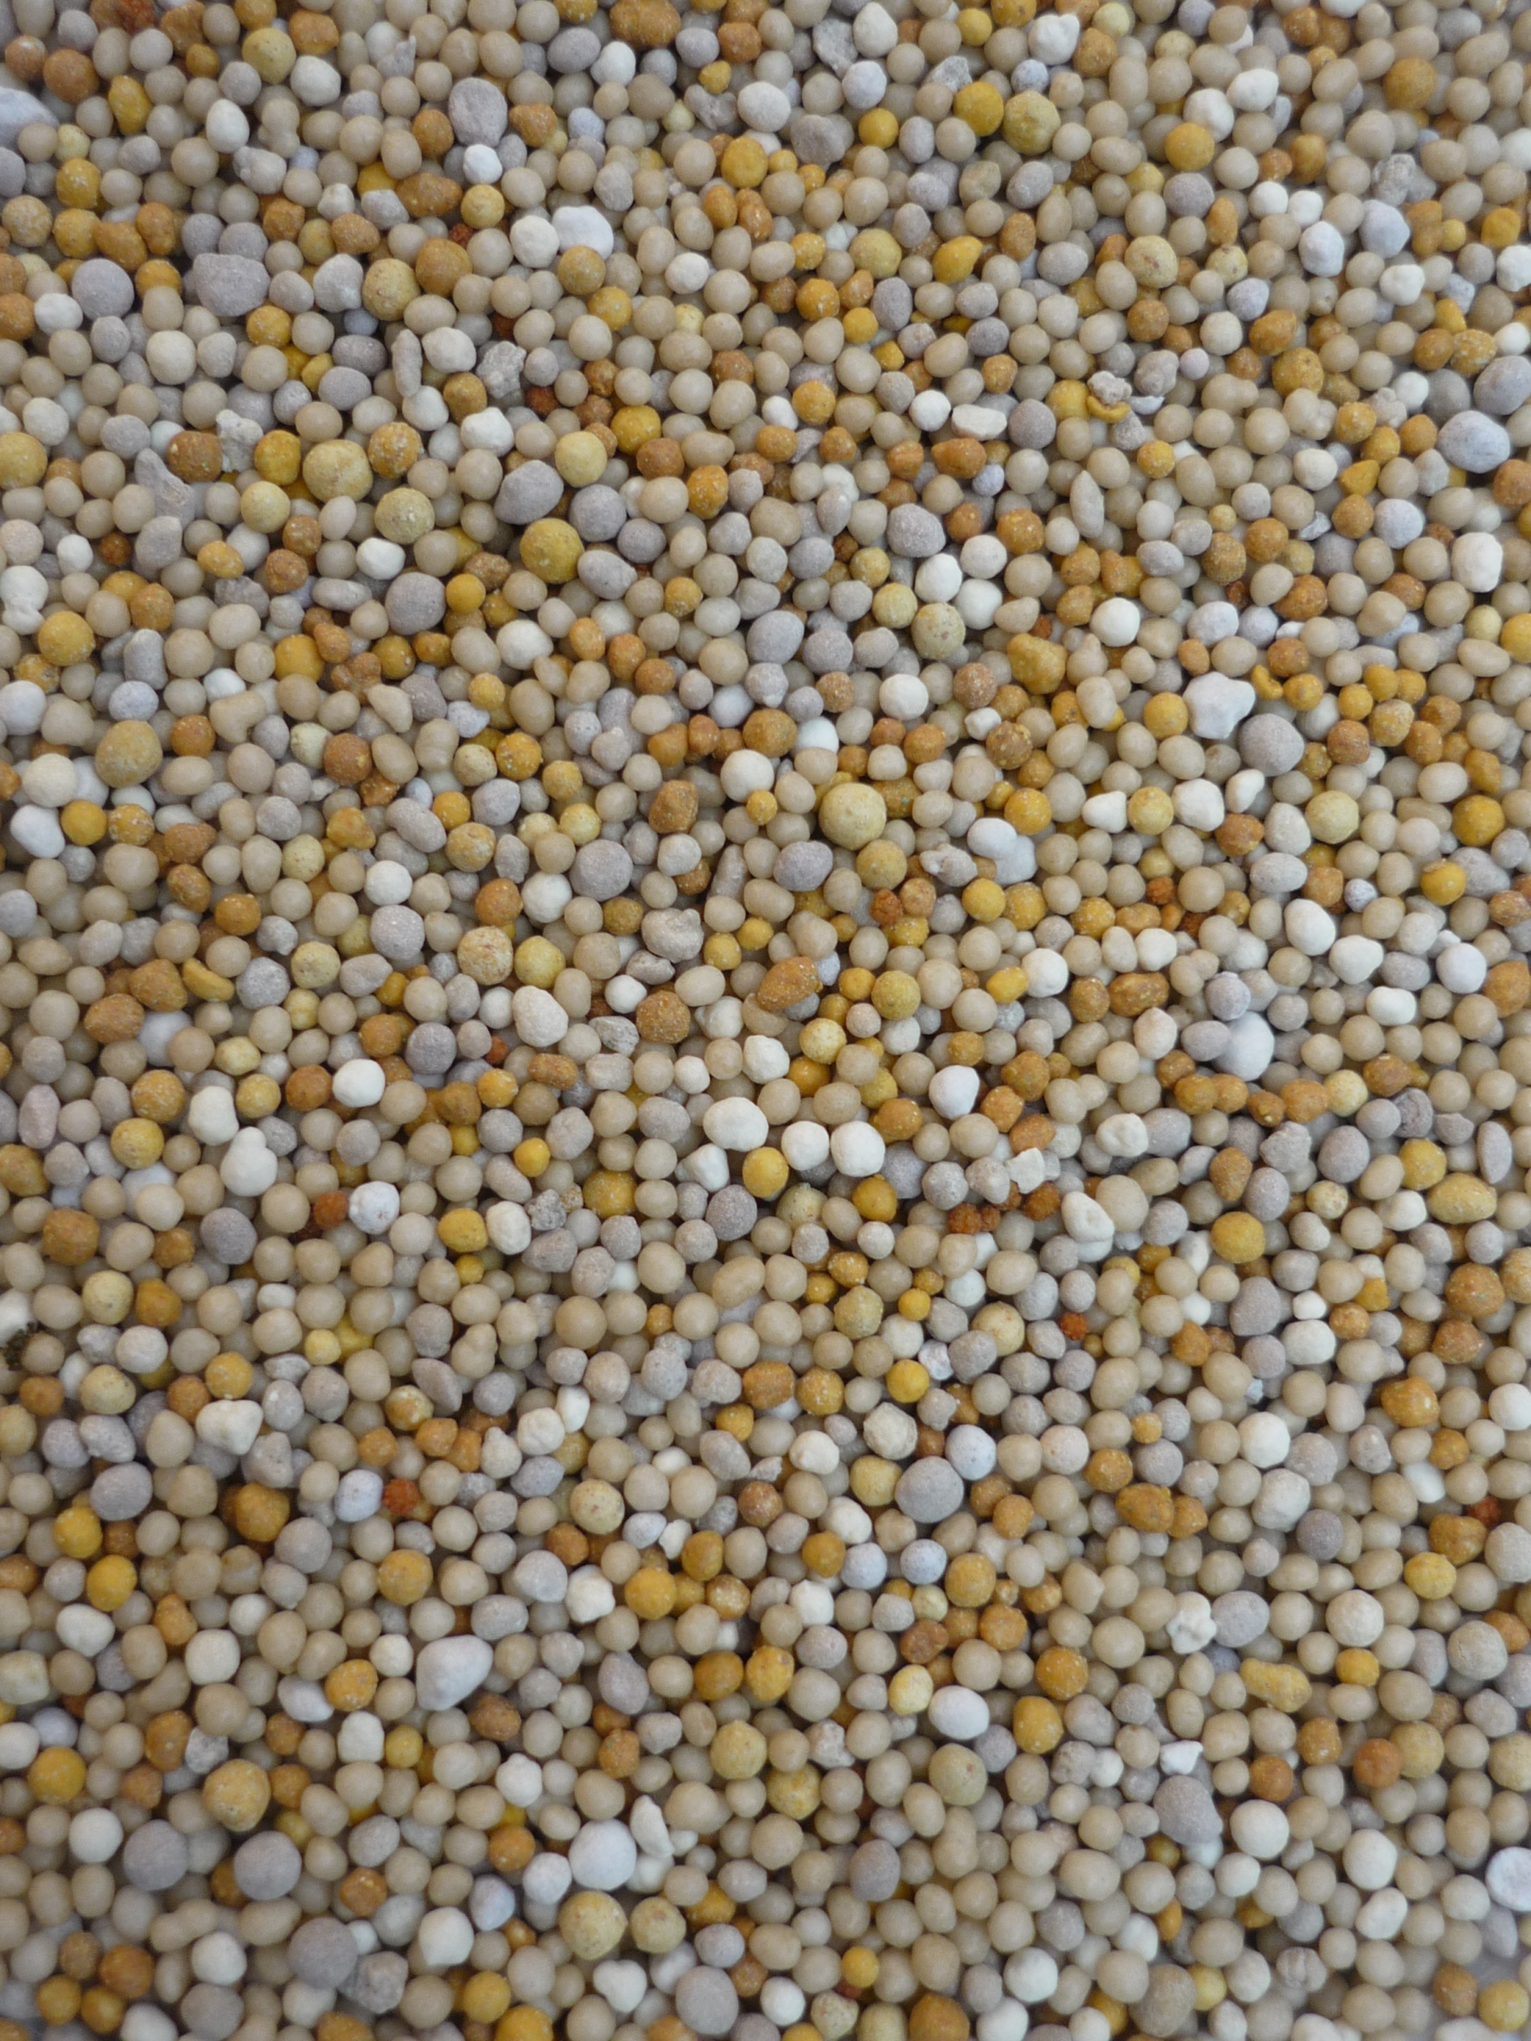


Standard
18+8+12+8,5MgO+TE
87% of N coated
Easy Summer
17+5+13+6MgO+TE
97% of N coated

Slide 35
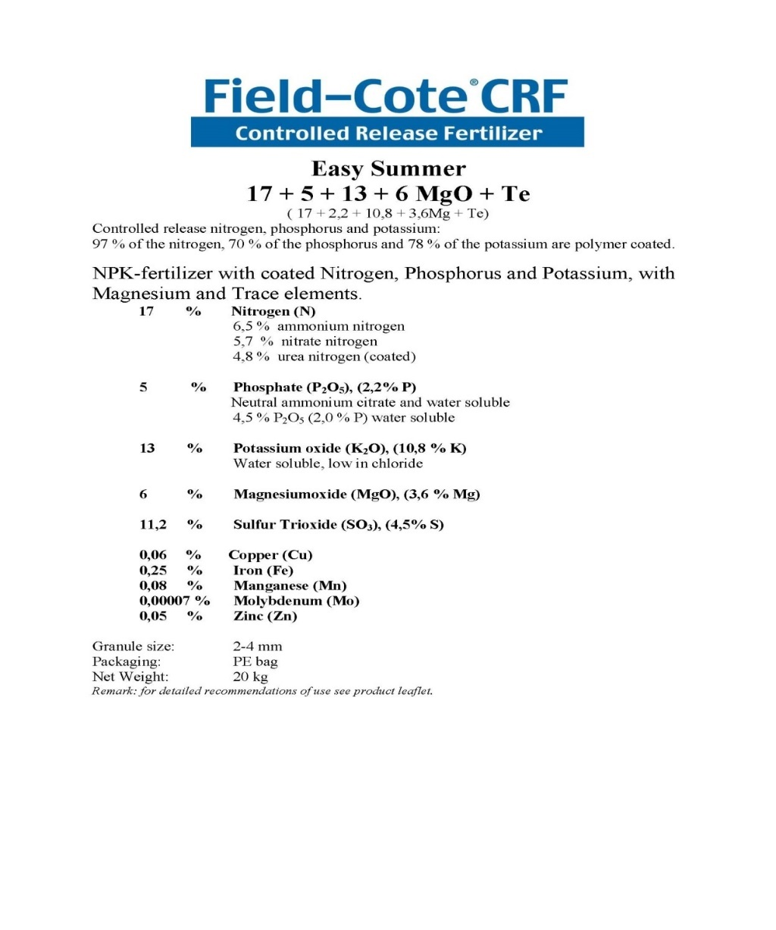

Slide 36
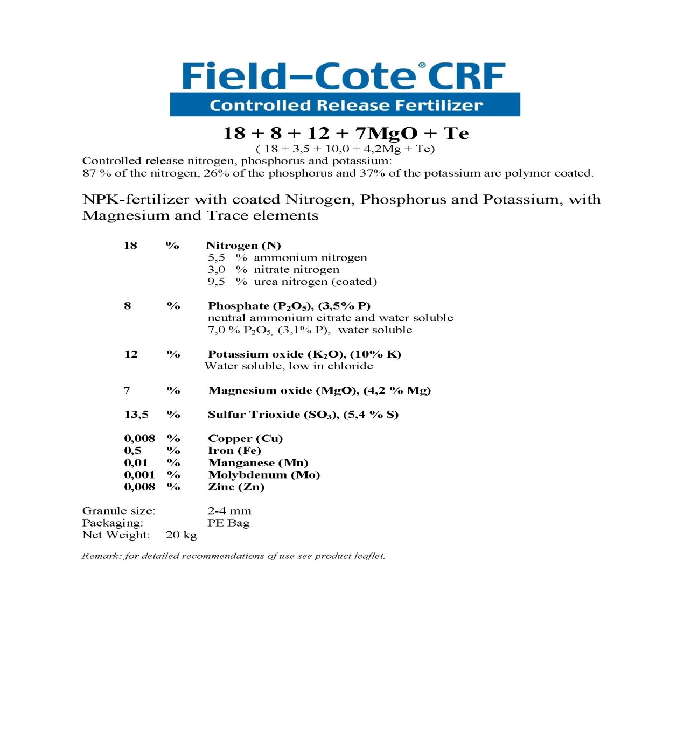

Slide 37
Recommendations vegetables
C.R.F. in Field grown vegetables/strawberries
Field-Cote®CRF 18+8+12+8,5MgO+Te 6M

Slide 38


Slide 39
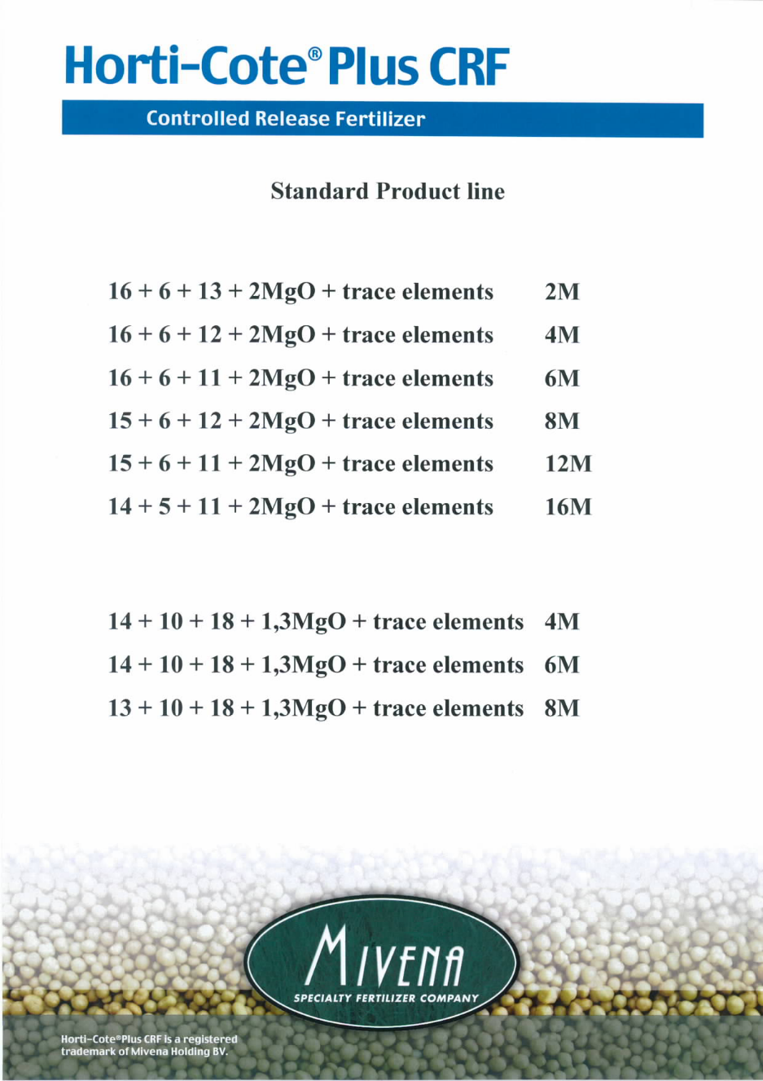

Slide 40

All nutrients are 100% coated
N+P+K +MgO
Longevities 4, 6, 8, 12, 16 Months
Uniform size: easy mixing in compost

Slide 41

All nutrients are 100% coated
N+P+K+MgO+trace elements
Longevities 4, 6, 8, 12, 16 Months
Uniform size -> easy mixing in compost

Slide 42
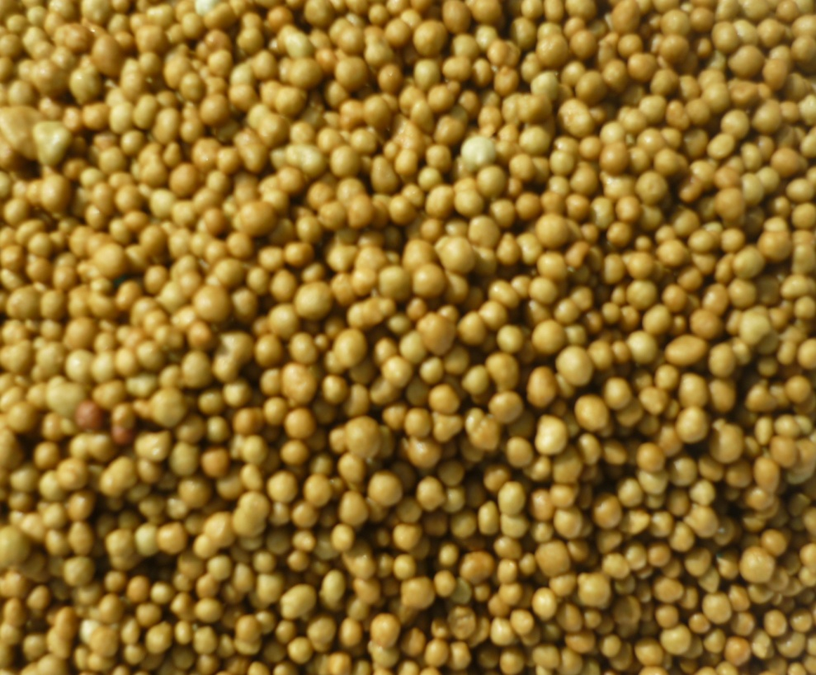

Slide 43
Products for the Market
Horti-Cote® / Horti-Cote plus®
Longevity: 2-4-6-8-12 M
Analyses: Normal 16+6+12 + 2+ traces
High K 14+10+18+ MgO+ traces
Coated fraction: 100% (no Urea)
Size: 1-3 mm
Competition: Osmocote/ Multicote/ Plantacote/ Basacote/ Mannacote/ Ekote / Nutricote.

Slide 44
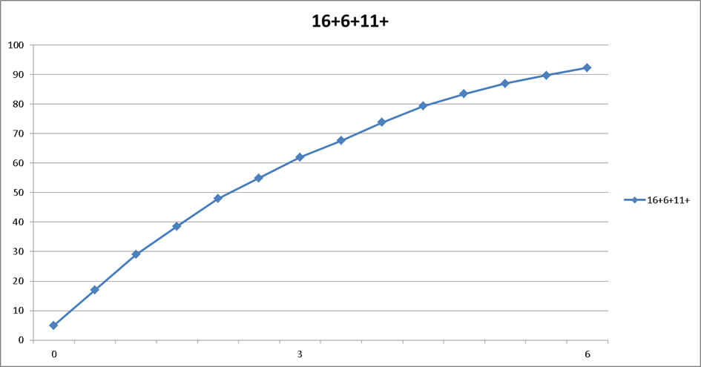
Typical Release Pattern 6 M

Slide 45
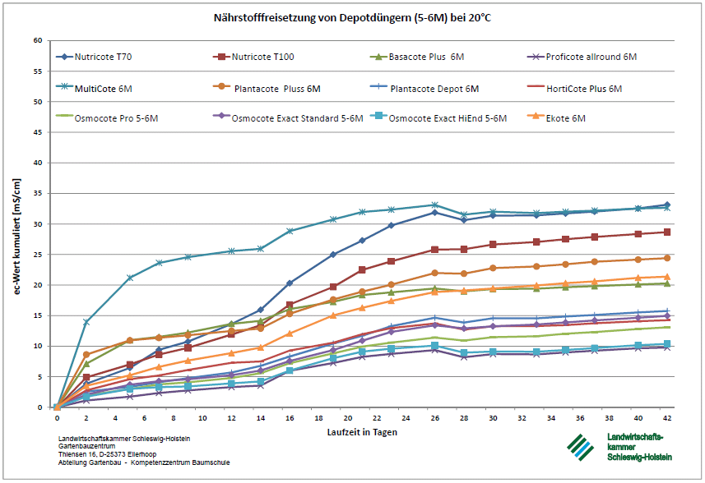

Slide 46



Slide 47

A 100% water soluble fertilizer in water above 8° Celsius
Trace Elements (TE) in chelated form
Fast acting
Leaf and liquid fertilization.
Plants species need trace elements for healthy colour and growth
All products contain MV10 which is for better uptake of all elements ( Vitamines )
100% soluble “free flowing” crystalline powder.

Slide 48
Important to apply TE regularly .
Plants are perfectly provided with chelated trace nutrients
(iron, manganese, copper, and zinc) even in poor conditions.
Free of sodium, chlorine and heavy metals.
Compositions to suit different needs.
MV 10 improves the speed of nutrients uptake.
MV 10 leads to a more efficient nutrients uptake.

Slide 49
Granusol
    Dry powder material /no liquid formulation.
    No transport of water/ avoid cost.
    All elements a 100% water soluble / no blockage of elements/ very fast in solution
    To be used in spraying/ no nossels blockage.
    To be used in irrigation/cleaning the system.
    High quality WSF/comparable with Millar greenhouse special and Peters Professional.
    Economical in use/ less cost versus comparable products.

Slide 50

Product line summery
Granusol®WSF
20 + 20 + 20 + 1MgO + traces MV10
20 + 10 + 20 + 1MgO + traces MV10
20 + 05 + 30 + 2MgO + traces MV10
20 + 05 + 10 + 2MgO + traces MV10
20 + 00 + 20 + 2MgO + traces MV10
12 + 07 + 24 + 2MgO + 7CaO + traces MV10
10 + 52 + 10 + 1MgO + traces MV10
10 + 10 + 30 + 6MgO + traces MV10
17+10+17+12CaO+traces MV10
18 + 06 + 26 + 3MgO + traces MV10
15 + 05 + 30 + 3MgO + traces MV10
07 + 12 + 36 + 3MgO + traces MV10
14+8+14+7CaO+3MgO+traces MV10 Olives

Slide 51

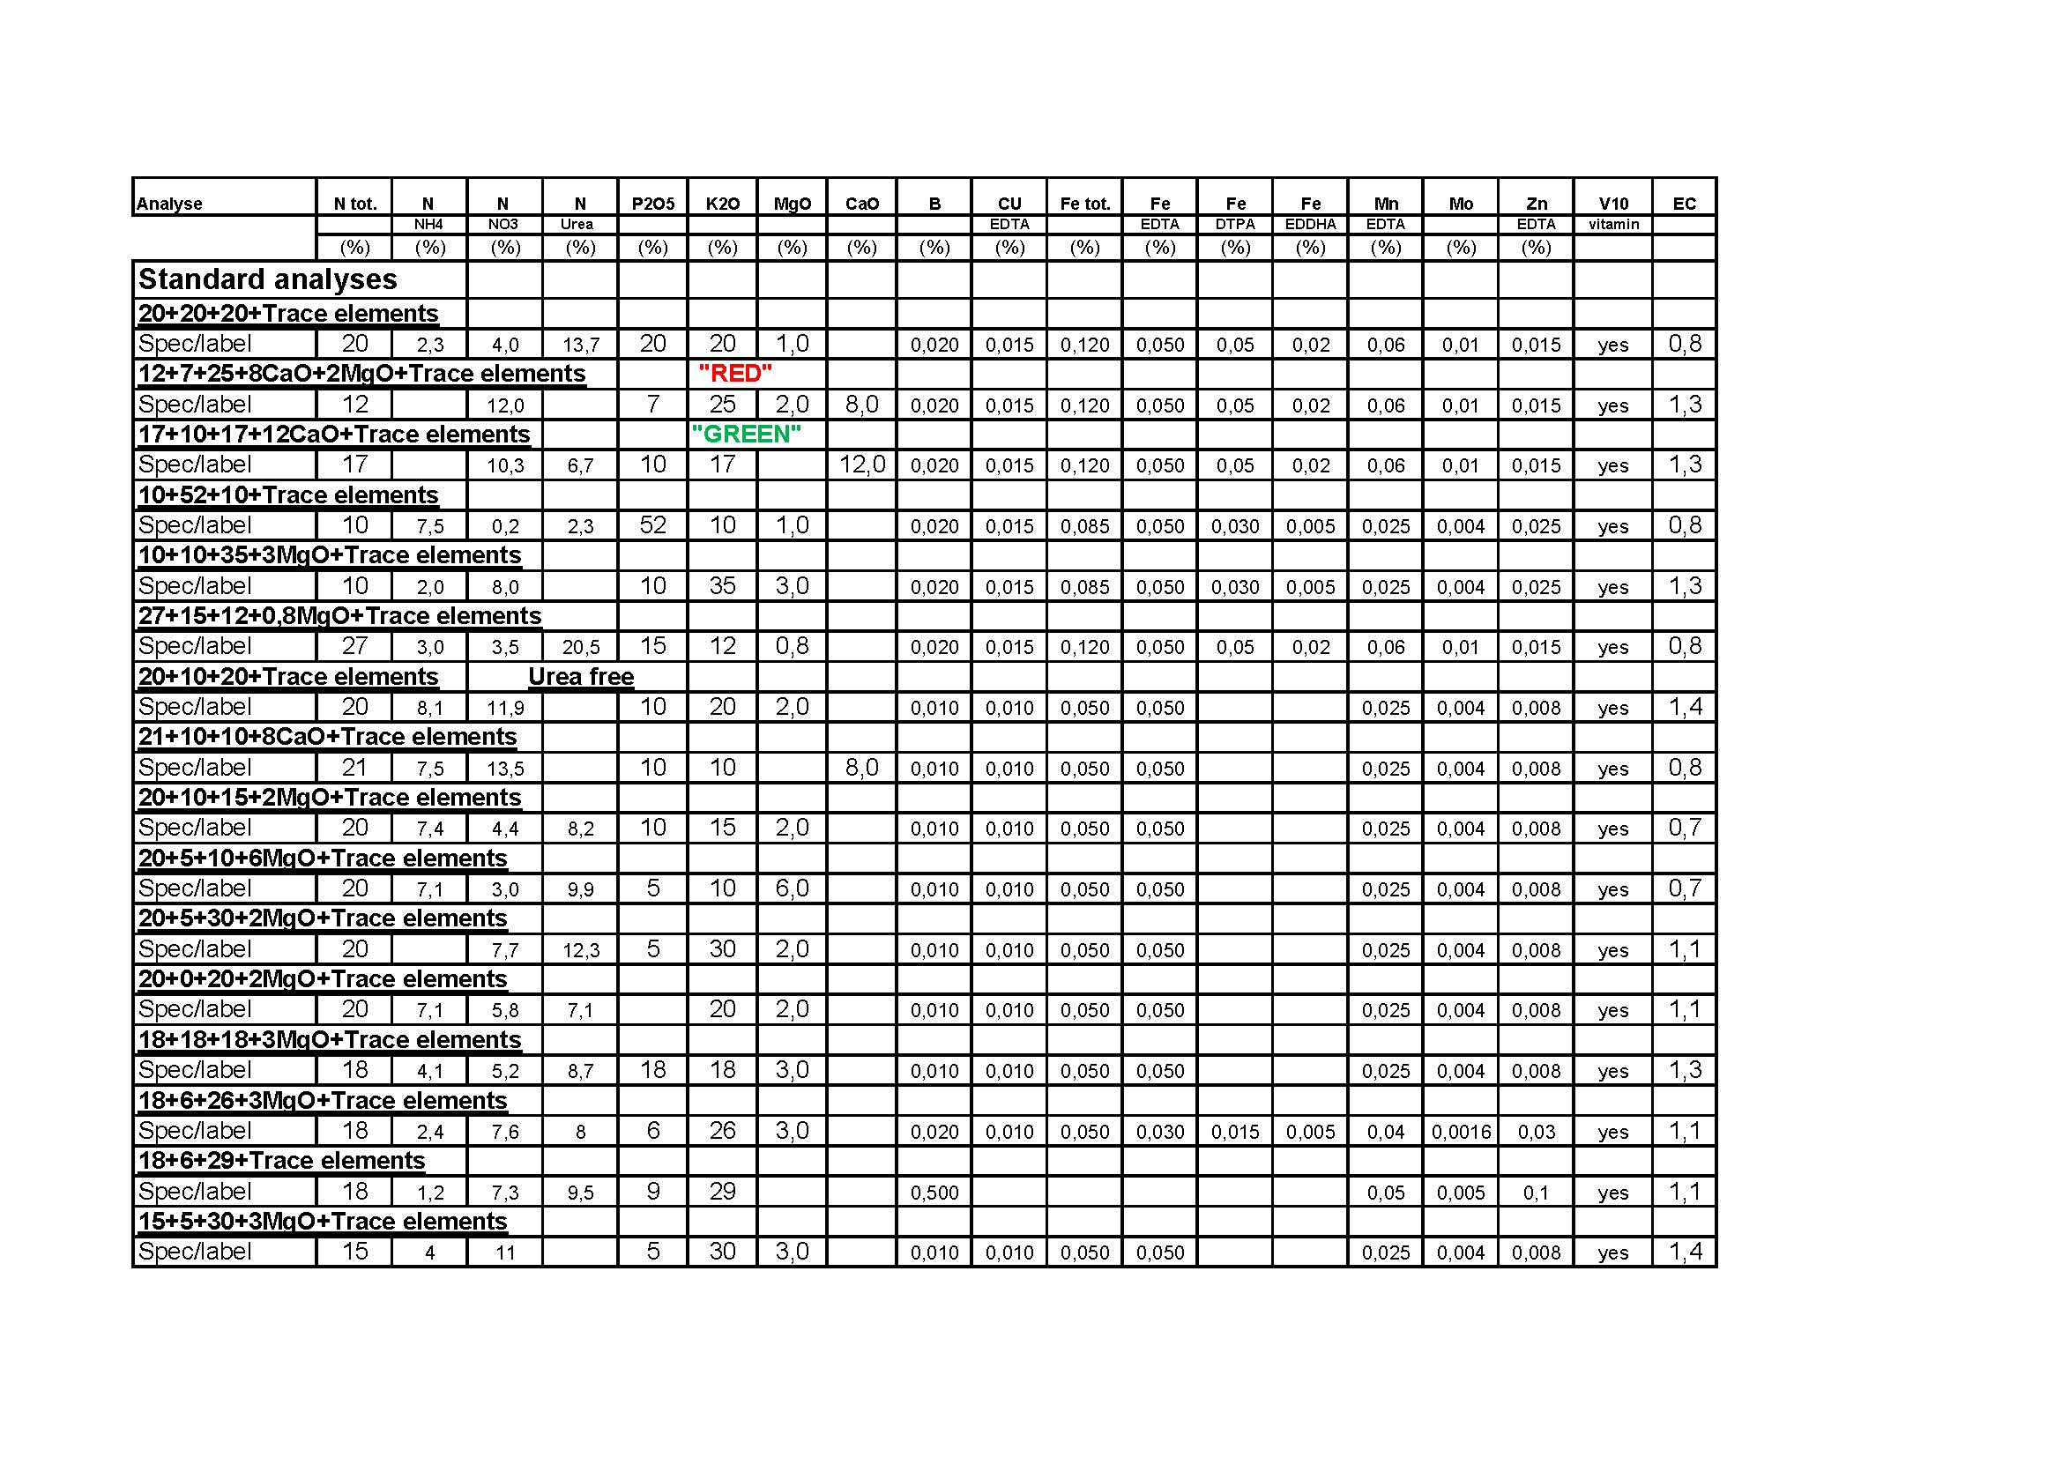

Slide 52
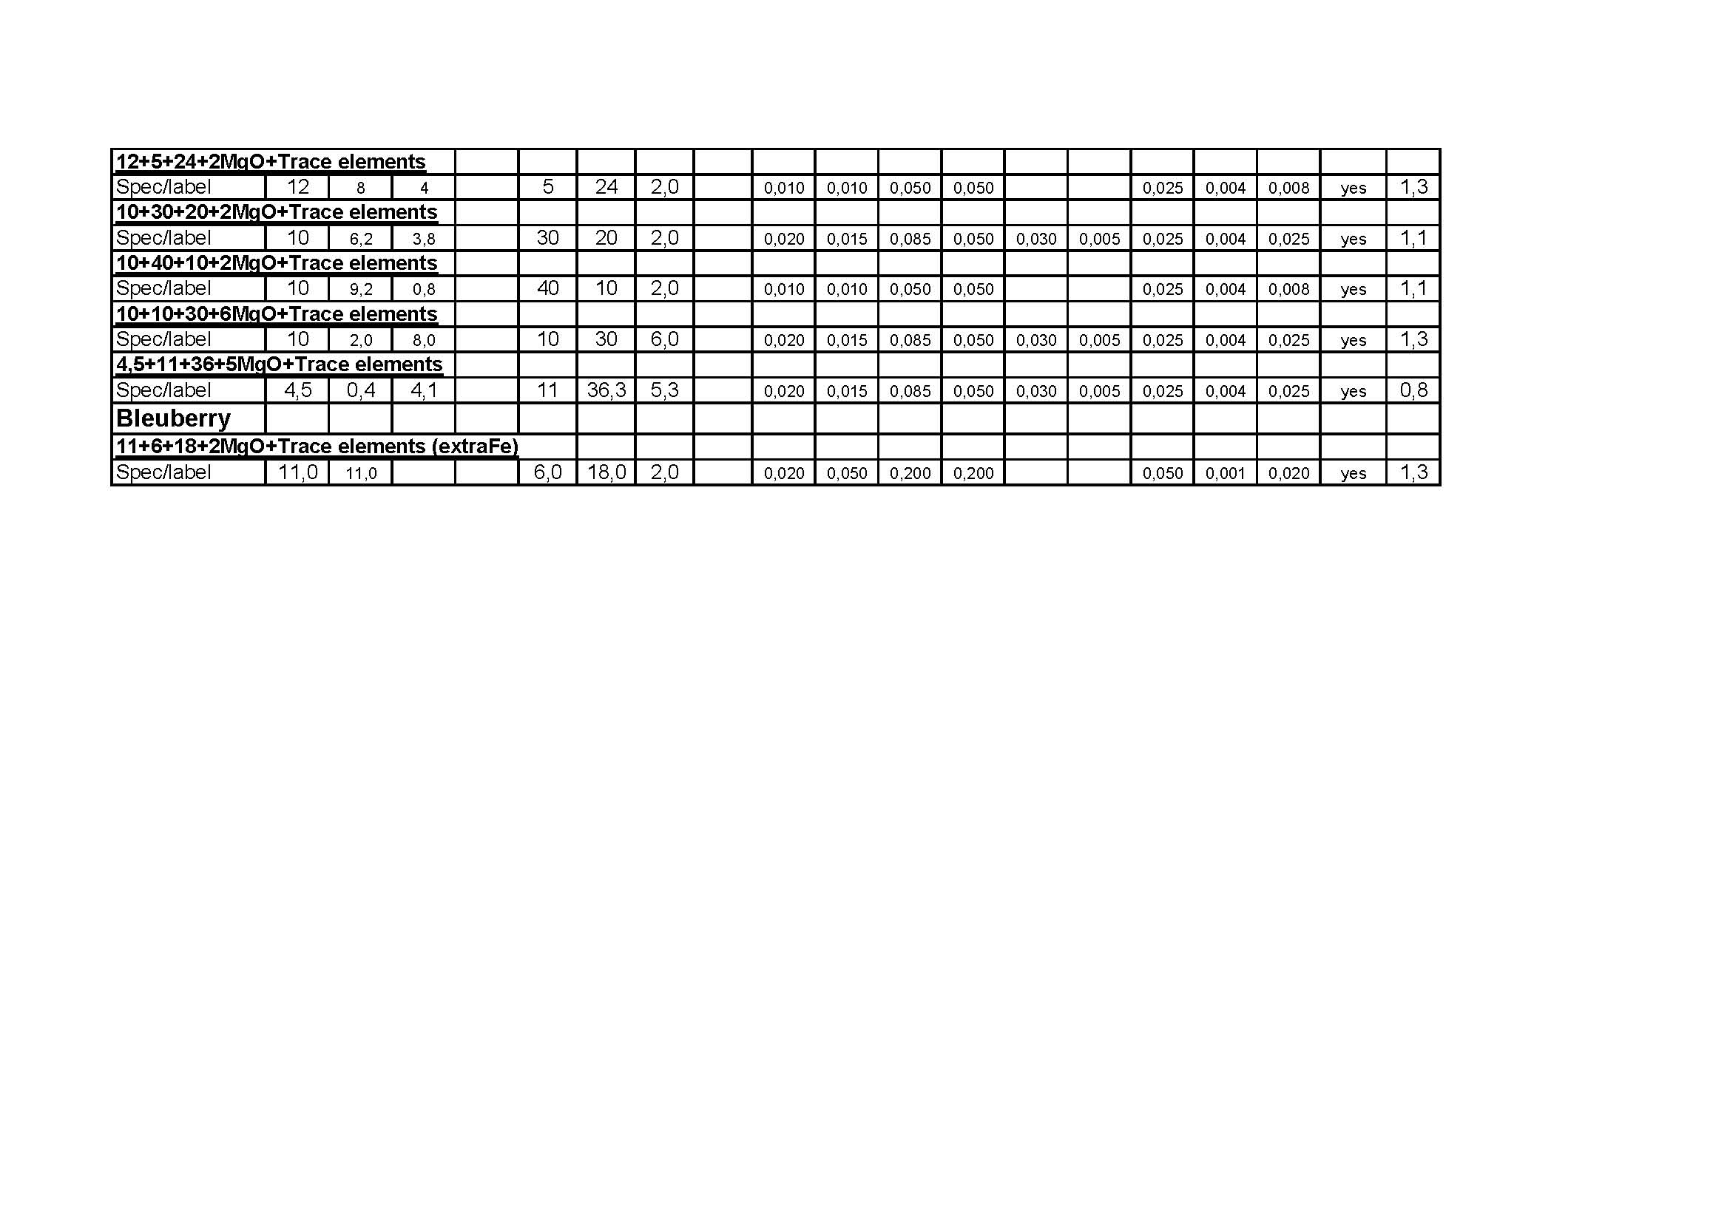

Slide 53
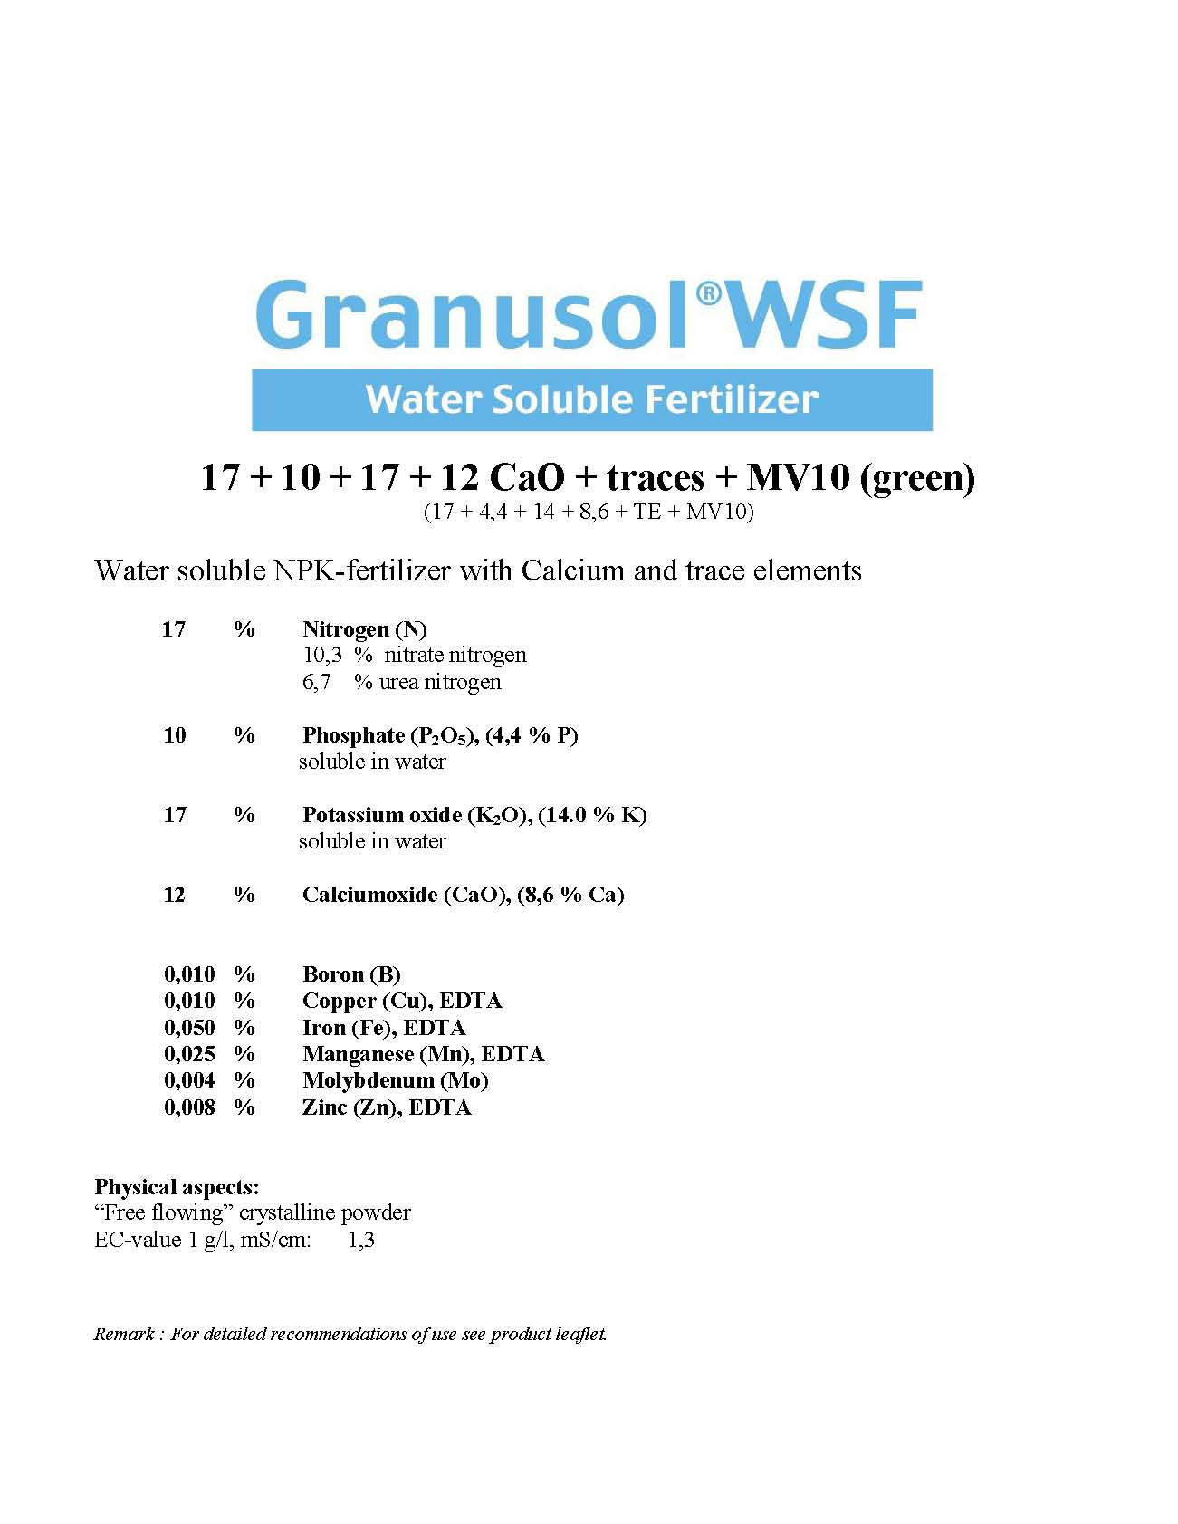

Slide 54
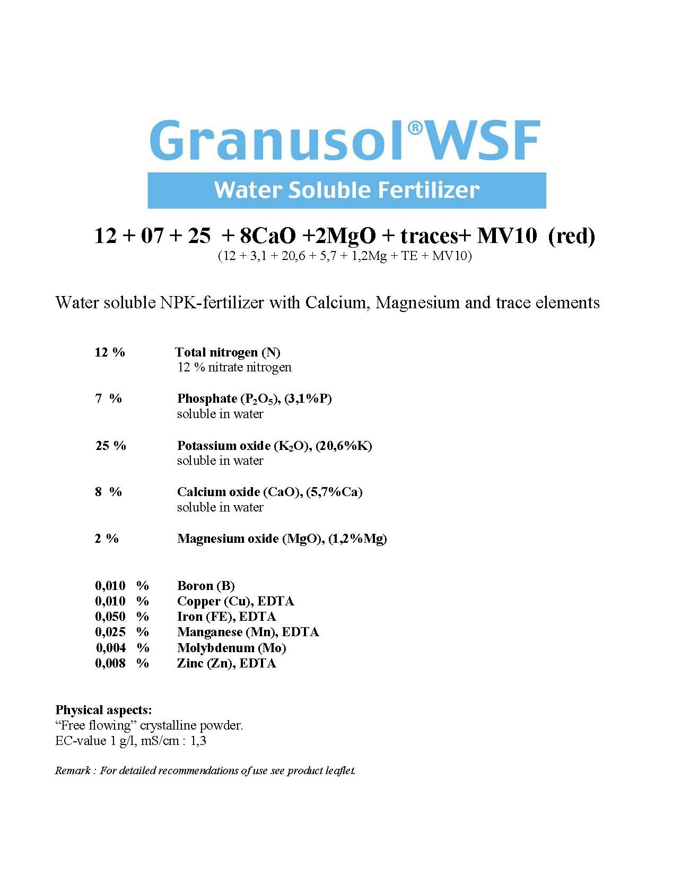

Slide 55
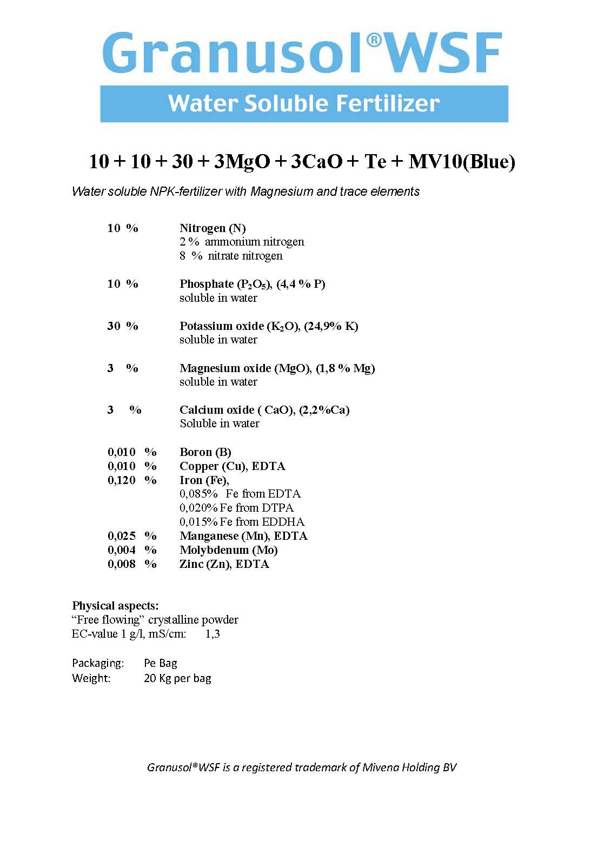

Slide 56
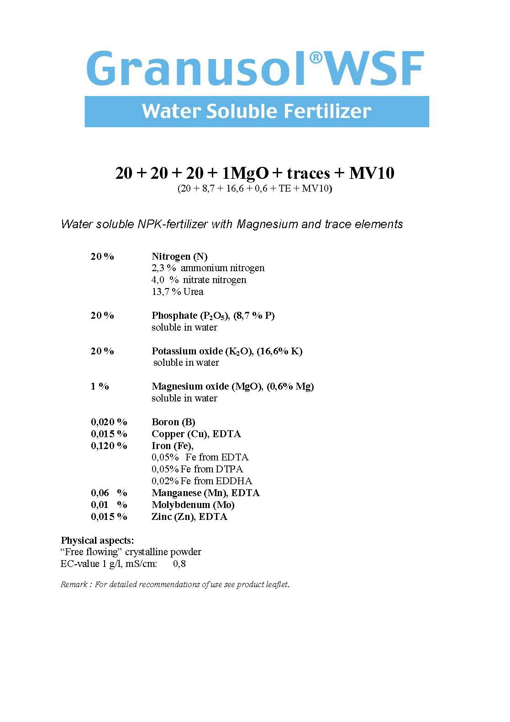

Slide 57
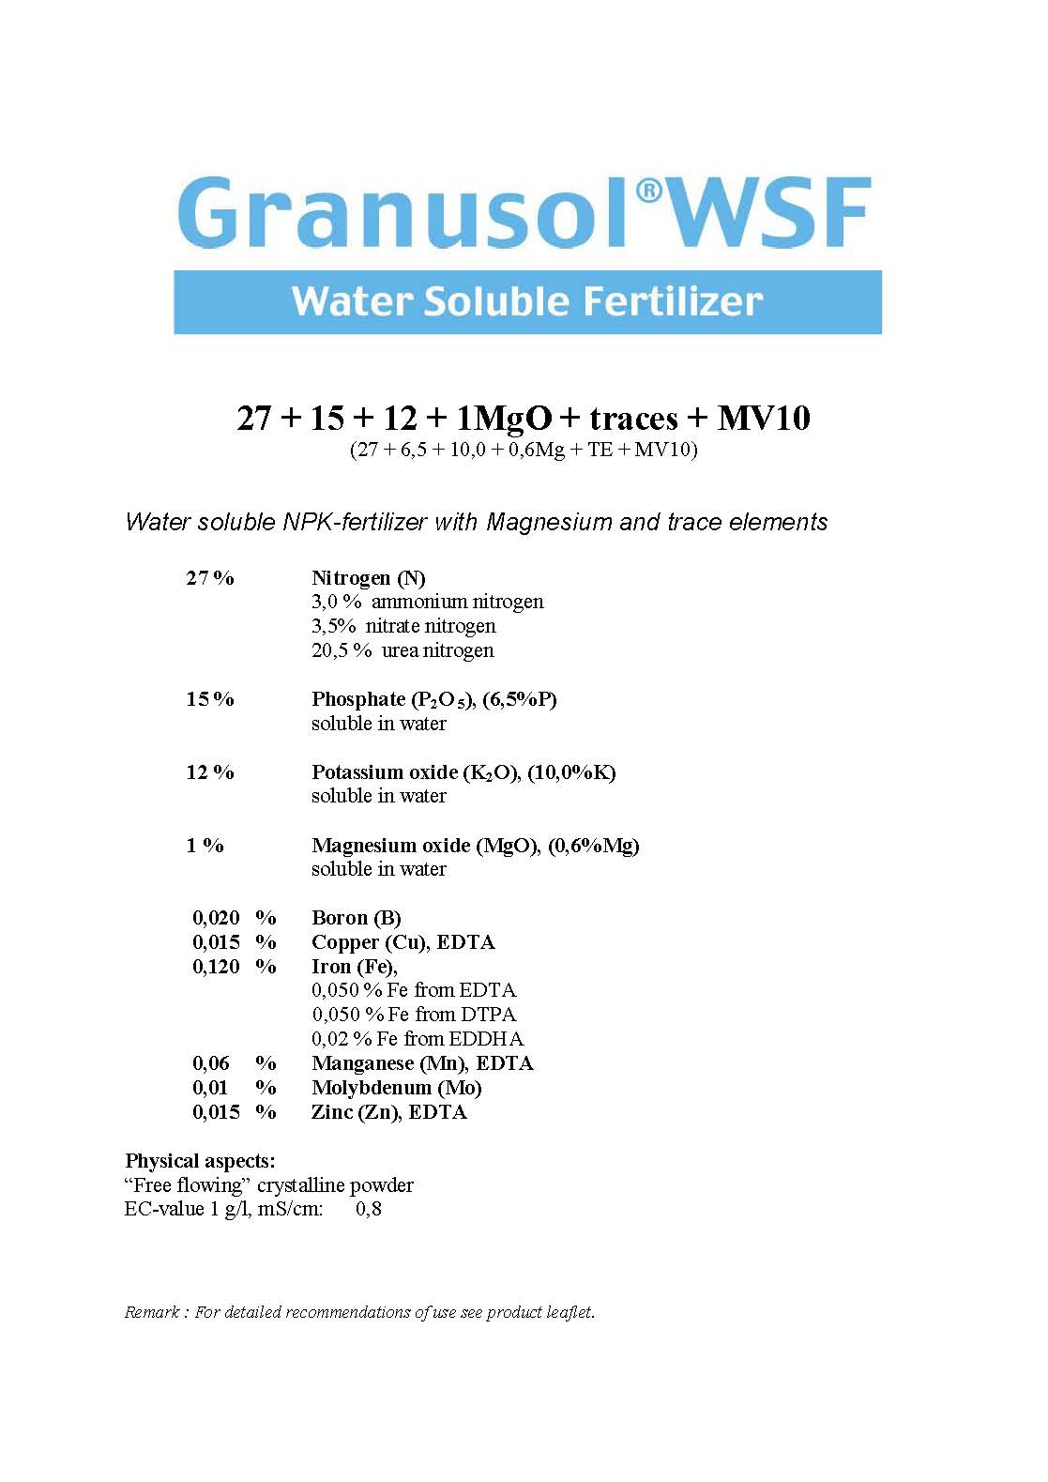

Slide 58

Fine-tuning
Field Grown CNS

Slide 59

Water soluble fertilizer for drip irrigation
Complete fertilizer
Complete range
Does not contain MV10
Less trace elements compared to Granusol
Price competitive
Not suitable for mixing in spray equipment

Slide 60
06-08-30+2MgO+TE
10-05-23+2,5MgO+TE
11-30-11+2MgO+TE
13-06-24+3MgO+6CaO+TE
16-06-16+3MgO+6CaO+TE
18-18-18+2MgO+TE
25-05-12+2MgO+TE
15-07-15+2MgO+TE
18-07-18+2MgO+TE

Slide 61


Slide 62
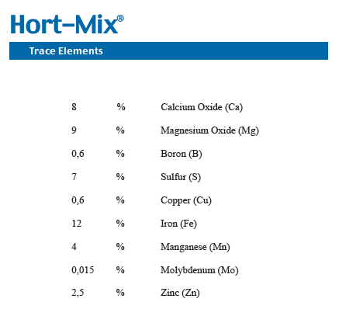

Slide 63
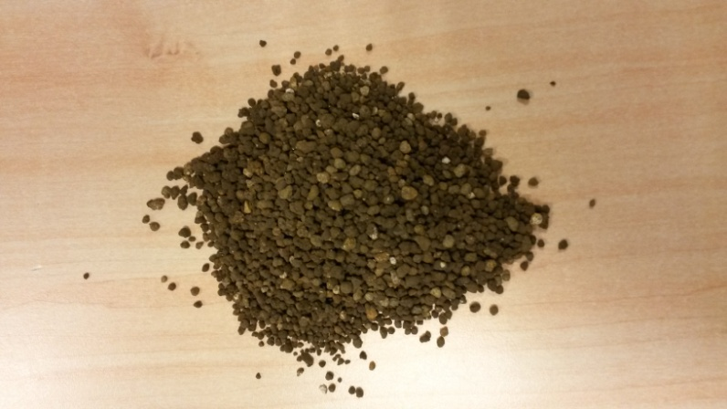
1-4 mm granul
Extra trace elements for the open field
Mixture in the potting soil and open field

Slide 64

Plant Production
Market leader in the Netherlands for plant production fertiliser
Fieldcote 18+8+12+8,5+TE 250 kg before planting
200 kg 18+8+12+8,5+TE before laying the runners
Granusol in the season

Slide 65
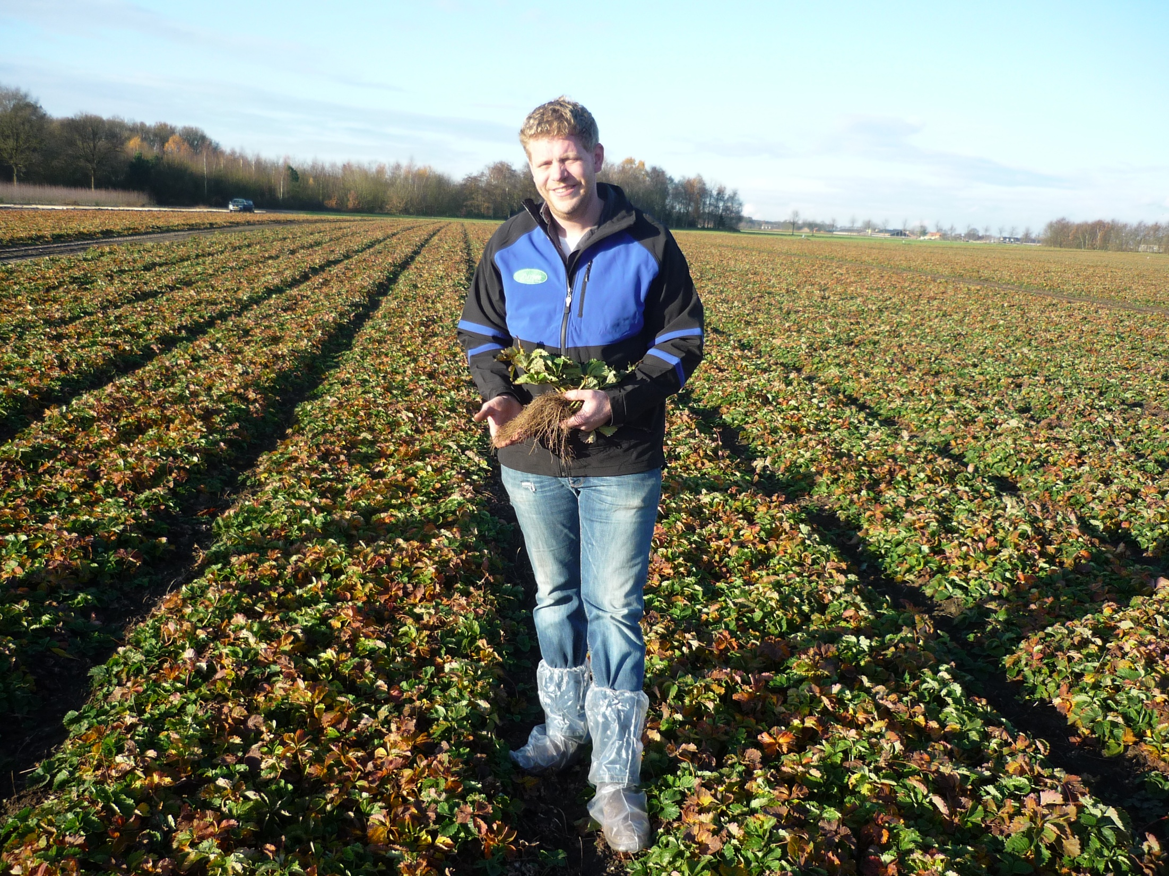

Slide 66
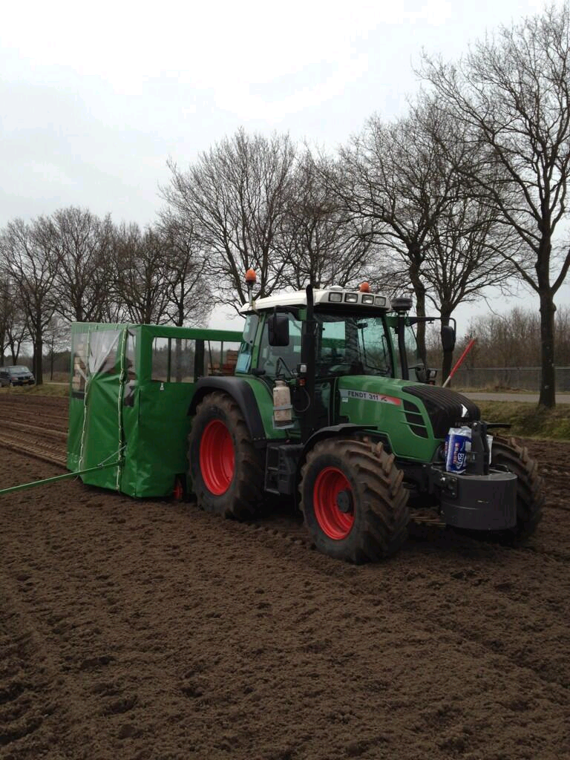

Slide 67
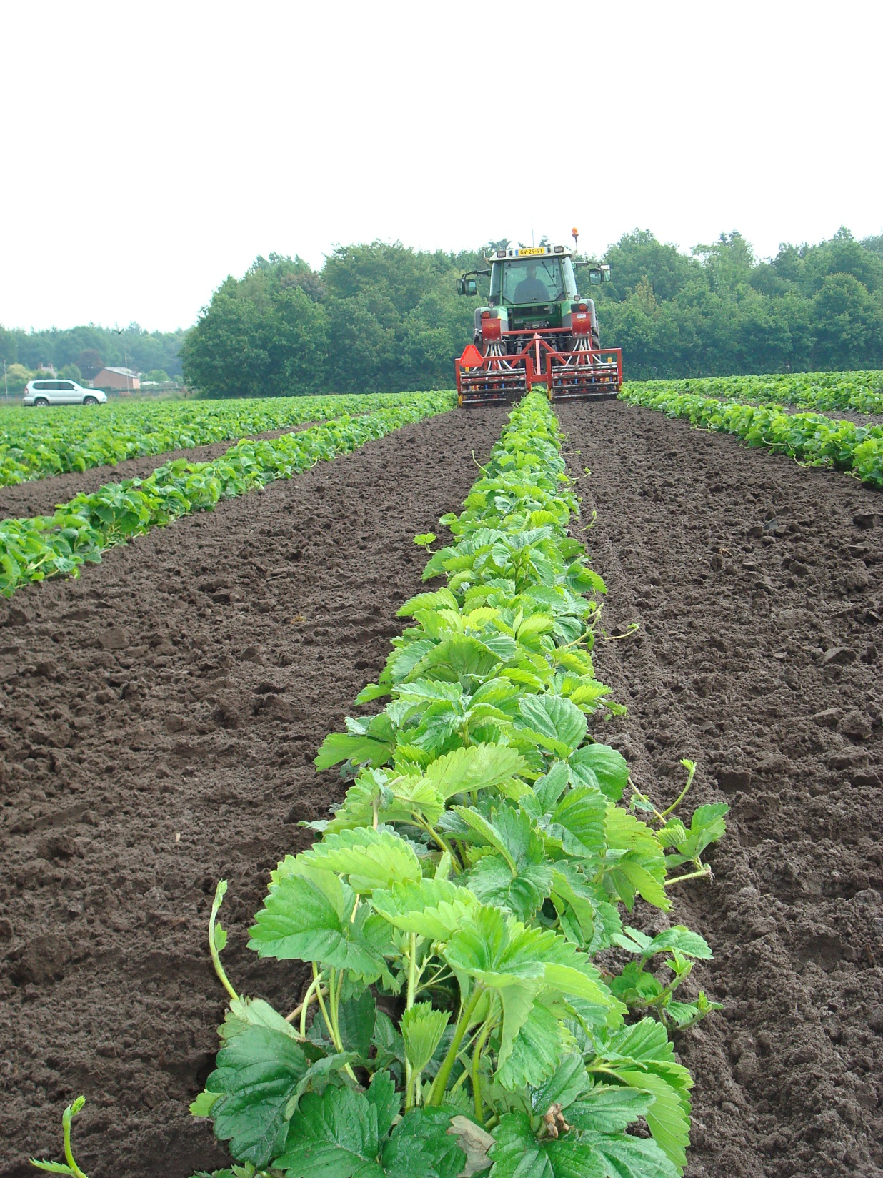

Slide 68
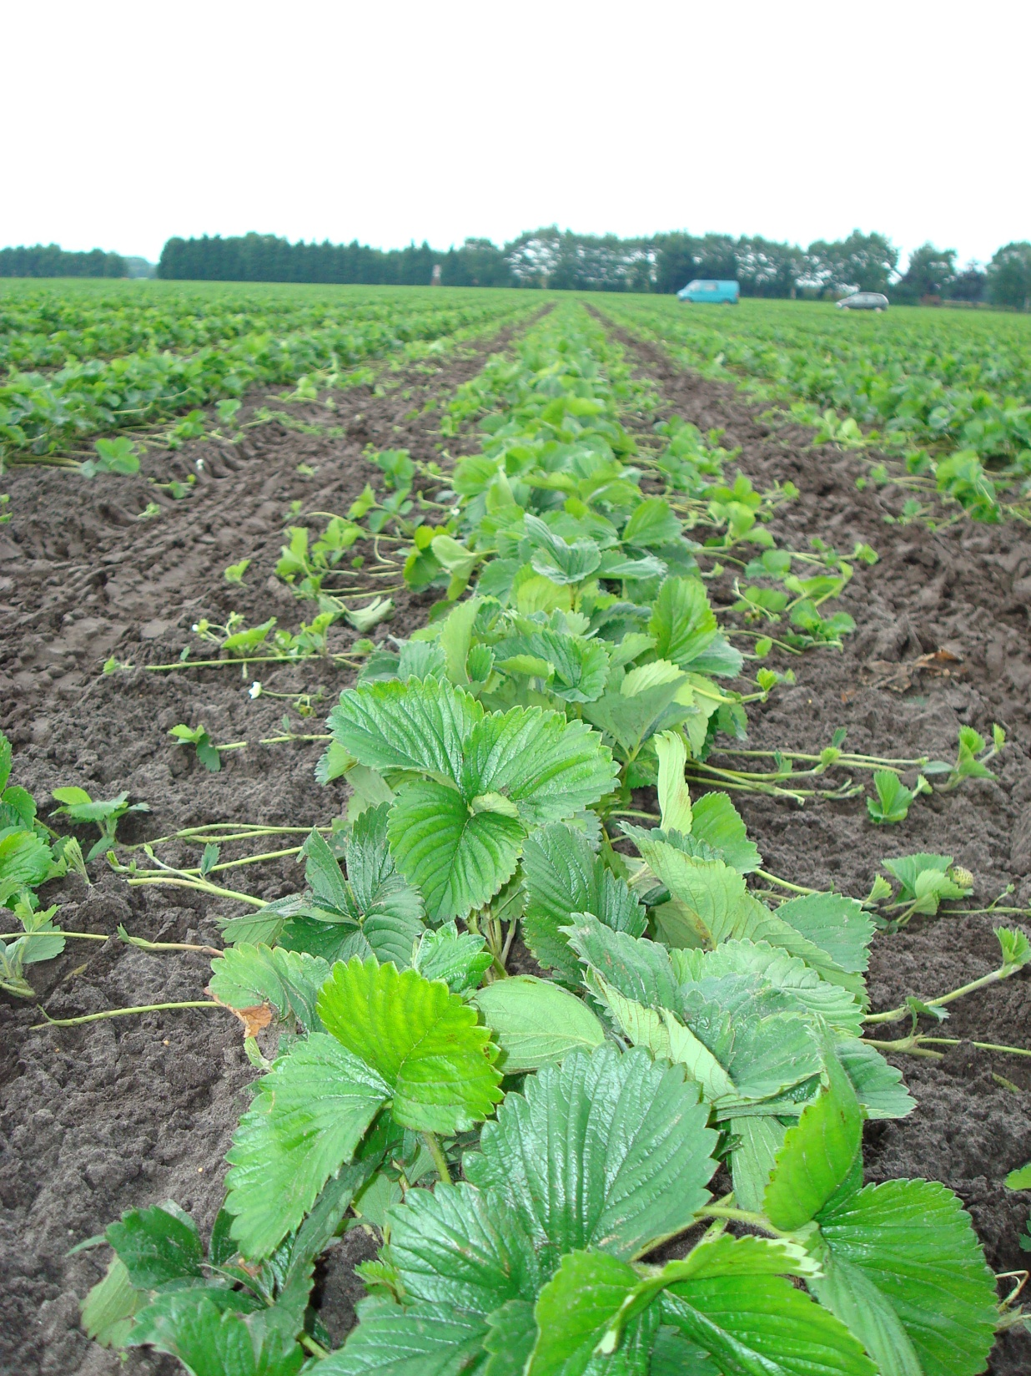

Slide 69
Waiting bed Culture (plant production)
Fieldcote 18+8+12+8,5+TE 4Mng
3-4 gram/ plants, 300-400 kg/ Ha
Granusol in the season
10+52+10

Slide 70
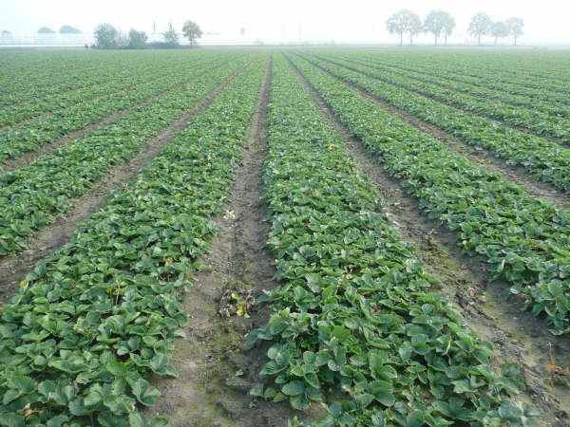

Slide 71
Normal Culture (fruit production)
Fieldcote 18+8+12+8,5+TE 8 M
15-18 gram/ plants, 300-400 kg/ Ha
Granusol in the season:
Granusol Red 12+7+25+2mgo+8CaO+TE
Granusol Green 17+10+17+12CaO+TE
Granusol Bleu 10+10+30+3MgO+3CaO+TE

Slide 72
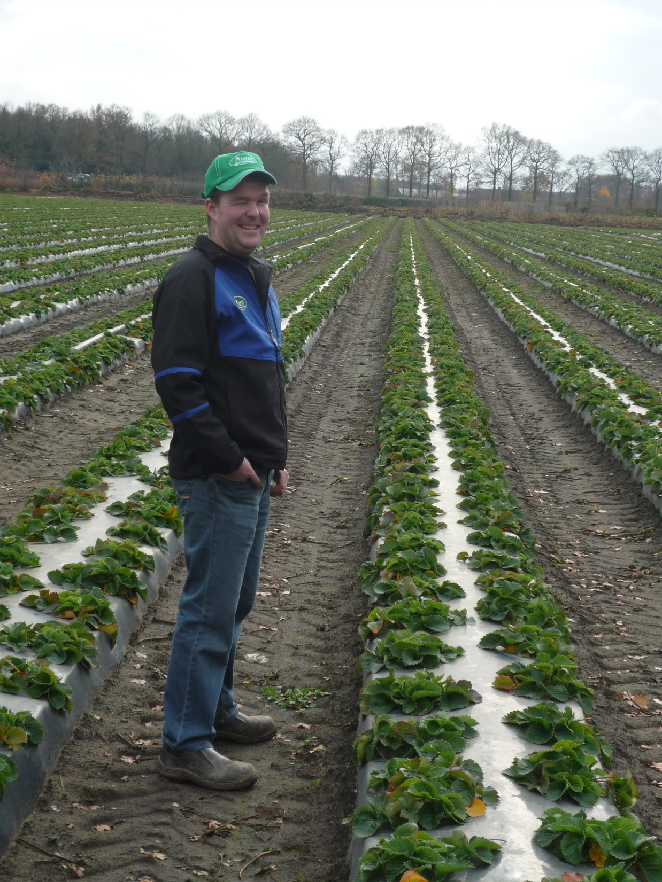

Slide 73
Frigo plants
Fieldcote 18+8+12+8,5+TE 4 M
10-14 gram/ plants, 300-400 kg/ Ha
Granusol in the season:
Granusol Red 12+7+25+2mgo+8CaO+TE
Granusol Green 17+10+17+12CaO+TE
Granusol Bleu 10+10+30+3MgO+3CaO+TE

Slide 74
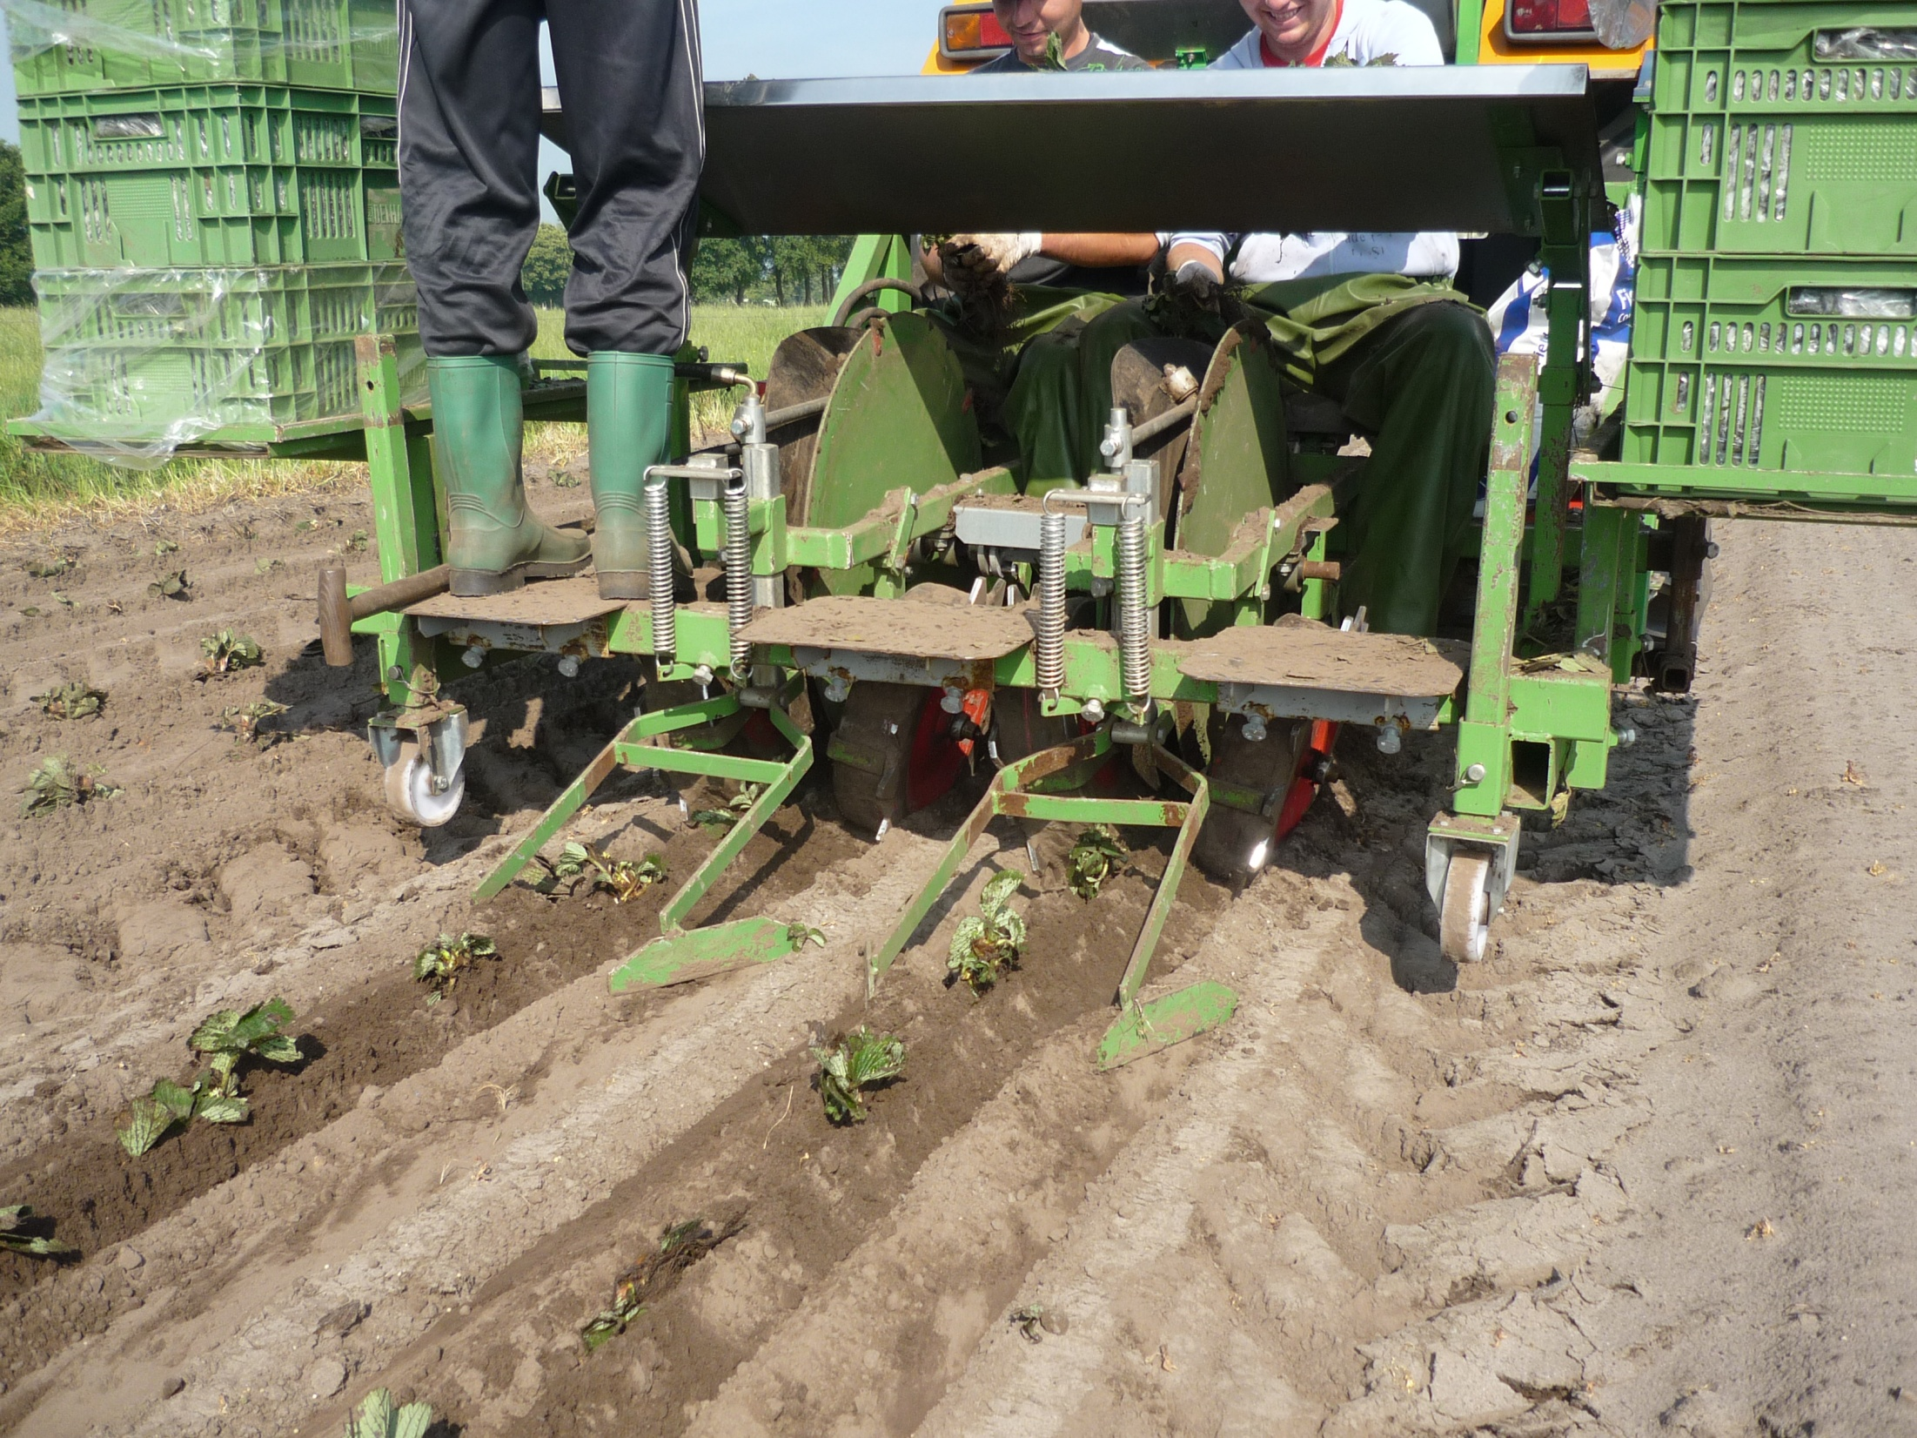
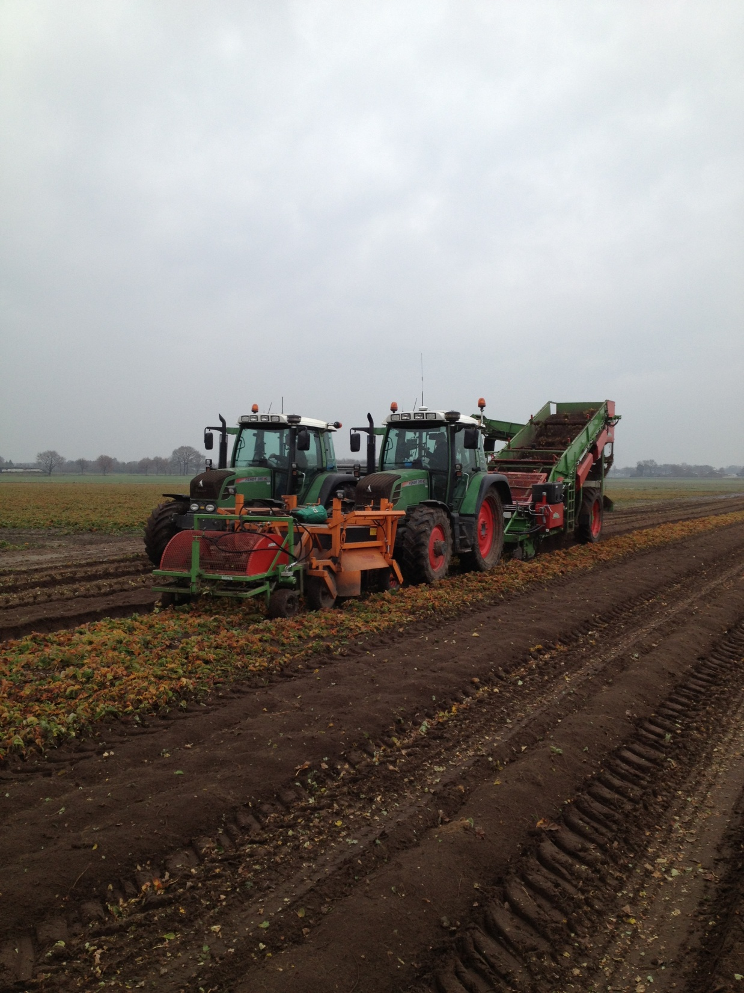


Slide 75
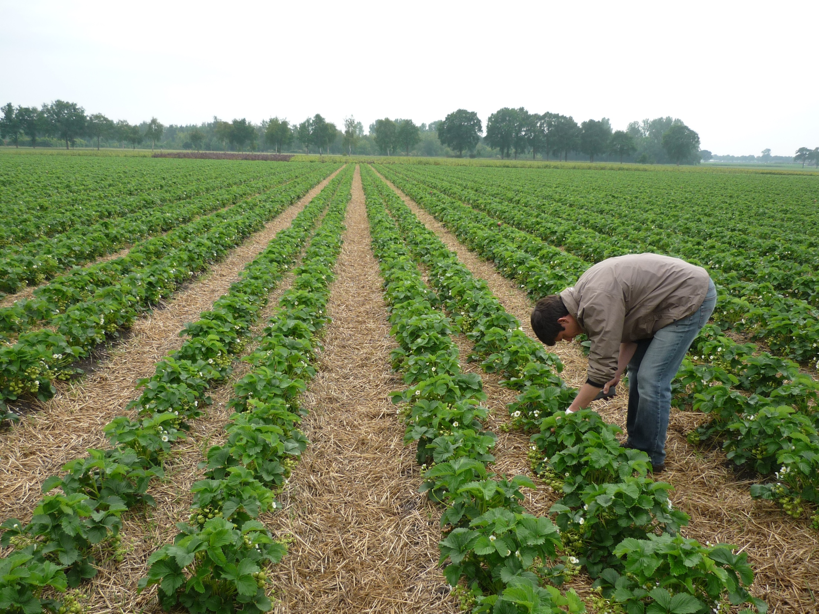

Slide 76
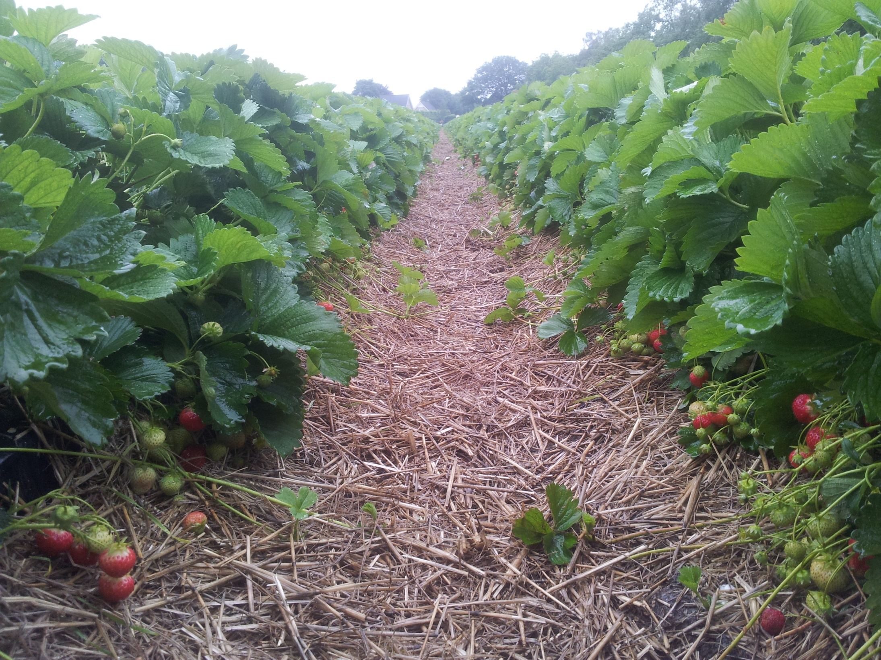

Slide 77
Advantage of the Mivena Fieldgrown system
1 application per season, less work, less cost for apllication
Duration coating technologie, constant release of nutrients
All nutrients in 1 fertilser (nkp + traces elements)
Release is only temperature based
100% water soluble fertilizer, very pure
Most trace elements in chelated EDTA form
Free of sodium, chlorine and heavy metals
- All analyse with mv 10 vitamine pack

Slide 78
Drip irrigation +
CRF +
Field-Cote +
=
ideal combination

Slide 79


Tray plants
Horticote plus CRF 16+6+11+2MgO 6m
3-5 kg / m3
Granusol Red/ Green/ Bleu

Slide 80
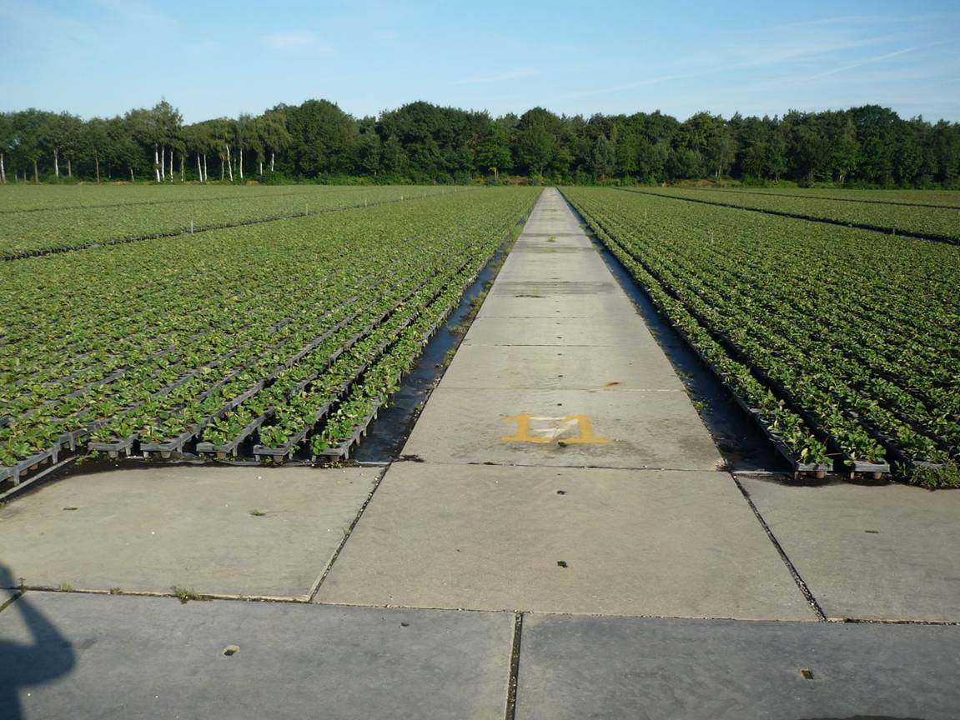

Slide 82
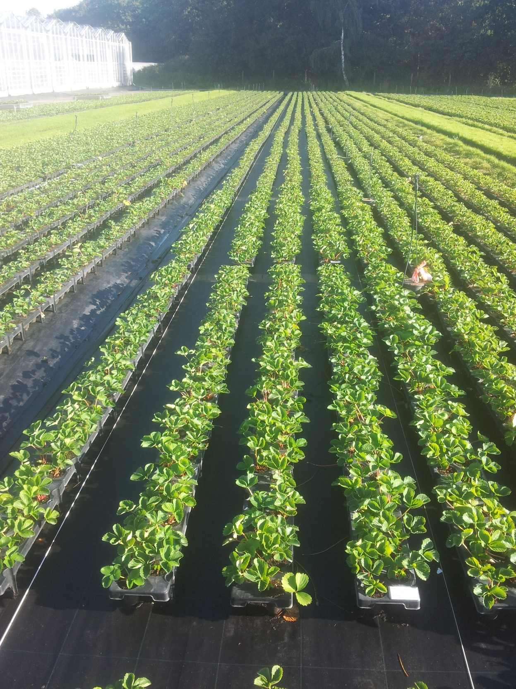

Slide 83
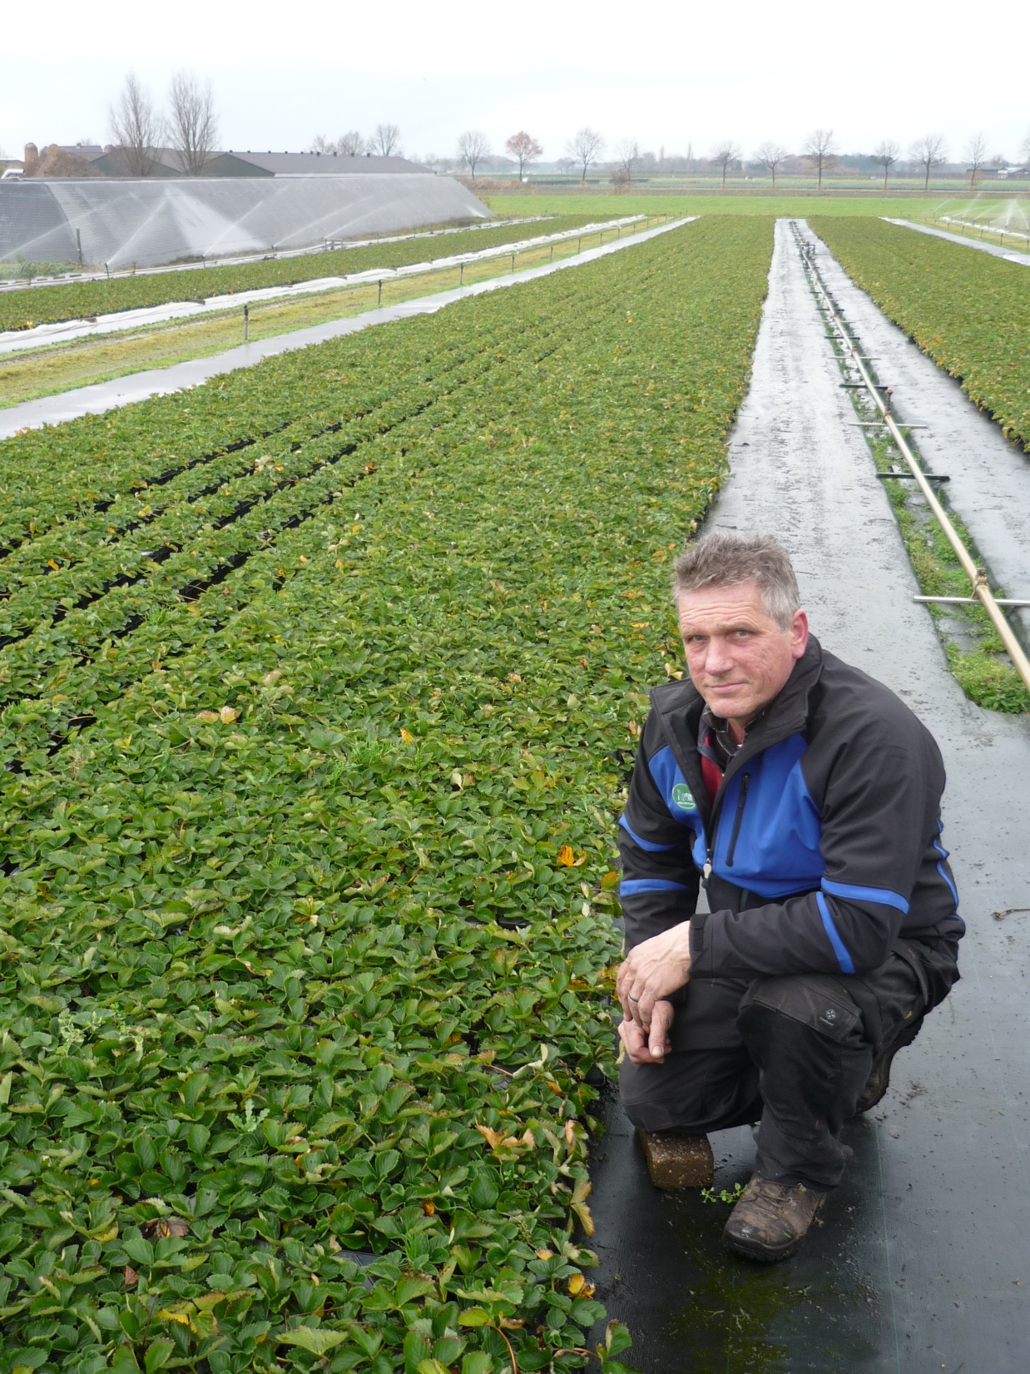

Slide 84
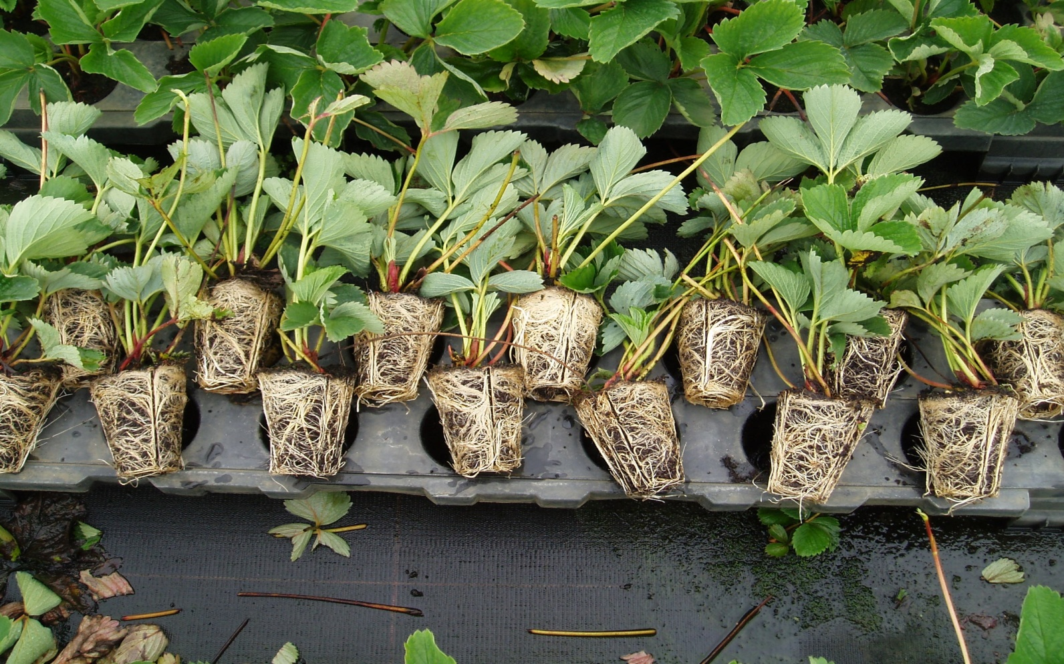
Horti-Cote®Plus root develop

Slide 85
Trayplant fertilization schedule
Basic fertilization: Horti-cote Plus 16+6+11+2MgO+TE 6M |  |  | 3-4 kg / ha
Week: | Analyse: | gram / m²: | kg / ha: | Units N:
33 | Granusol®WSF 20+20+20+1MgO+TE | 2 | 20 | 4
34 | Granusol®WSF 20+20+20+1MgO+TE | 2 | 20 | 4
35 | Granusol®WSF 12+7+25+2MgO+8CaO+TE | 6 | 60 | 7,2
36 | Granusol®WSF 20+10+20+1MgO+TE | 4 | 40 | 8
37 | Granusol®WSF 12+7+25+2MgO+8CaO+TE | 8 | 80 | 9,6
38 | Granusol®WSF 20+10+20+1MgO+TE | 6 | 60 | 12
39 | Granusol®WSF 12+7+25+2MgO+8CaO+TE | 10 | 100 | 12
40 | Granusol®WSF 20+10+20+1MgO+TE | 8 | 80 | 14
41 | Granusol®WSF 12+7+25+2MgO+8CaO+TE | 10 | 100 | 12
42 | Granusol®WSF 20+10+20+1MgO+TE | 8 | 80 | 14
43 | Granusol®WSF 12+7+25+2MgO+8CaO+TE | 6 | 60 | 7,2
44 | Granusol®WSF 20+10+20+1MgO+TE | 4 | 40 | 8
45 | Granusol®WSF 12+7+25+2MgO+8CaO+TE | 4 | 40 | 4,8
Total |  | 78 | 780 | 116,8

Slide 86
Table grown
Base of CRF fertiliser in the potting soil
2kg/ m3 horticote plus 16+6+11 6m
Granusol Red/ Green/ Bleu

Slide 87
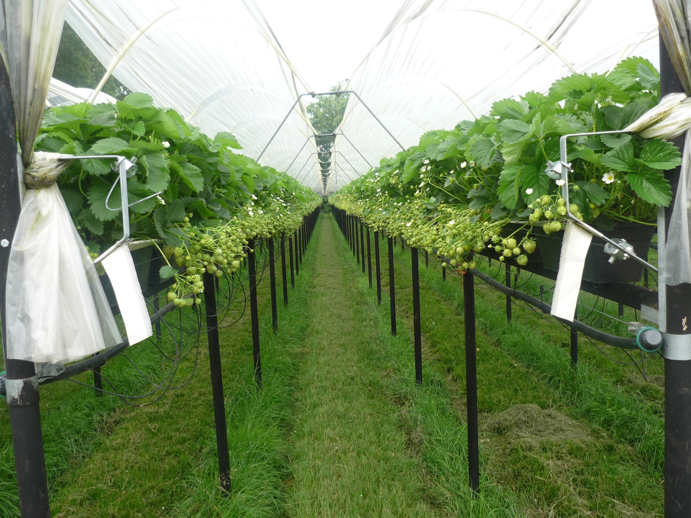

Slide 88
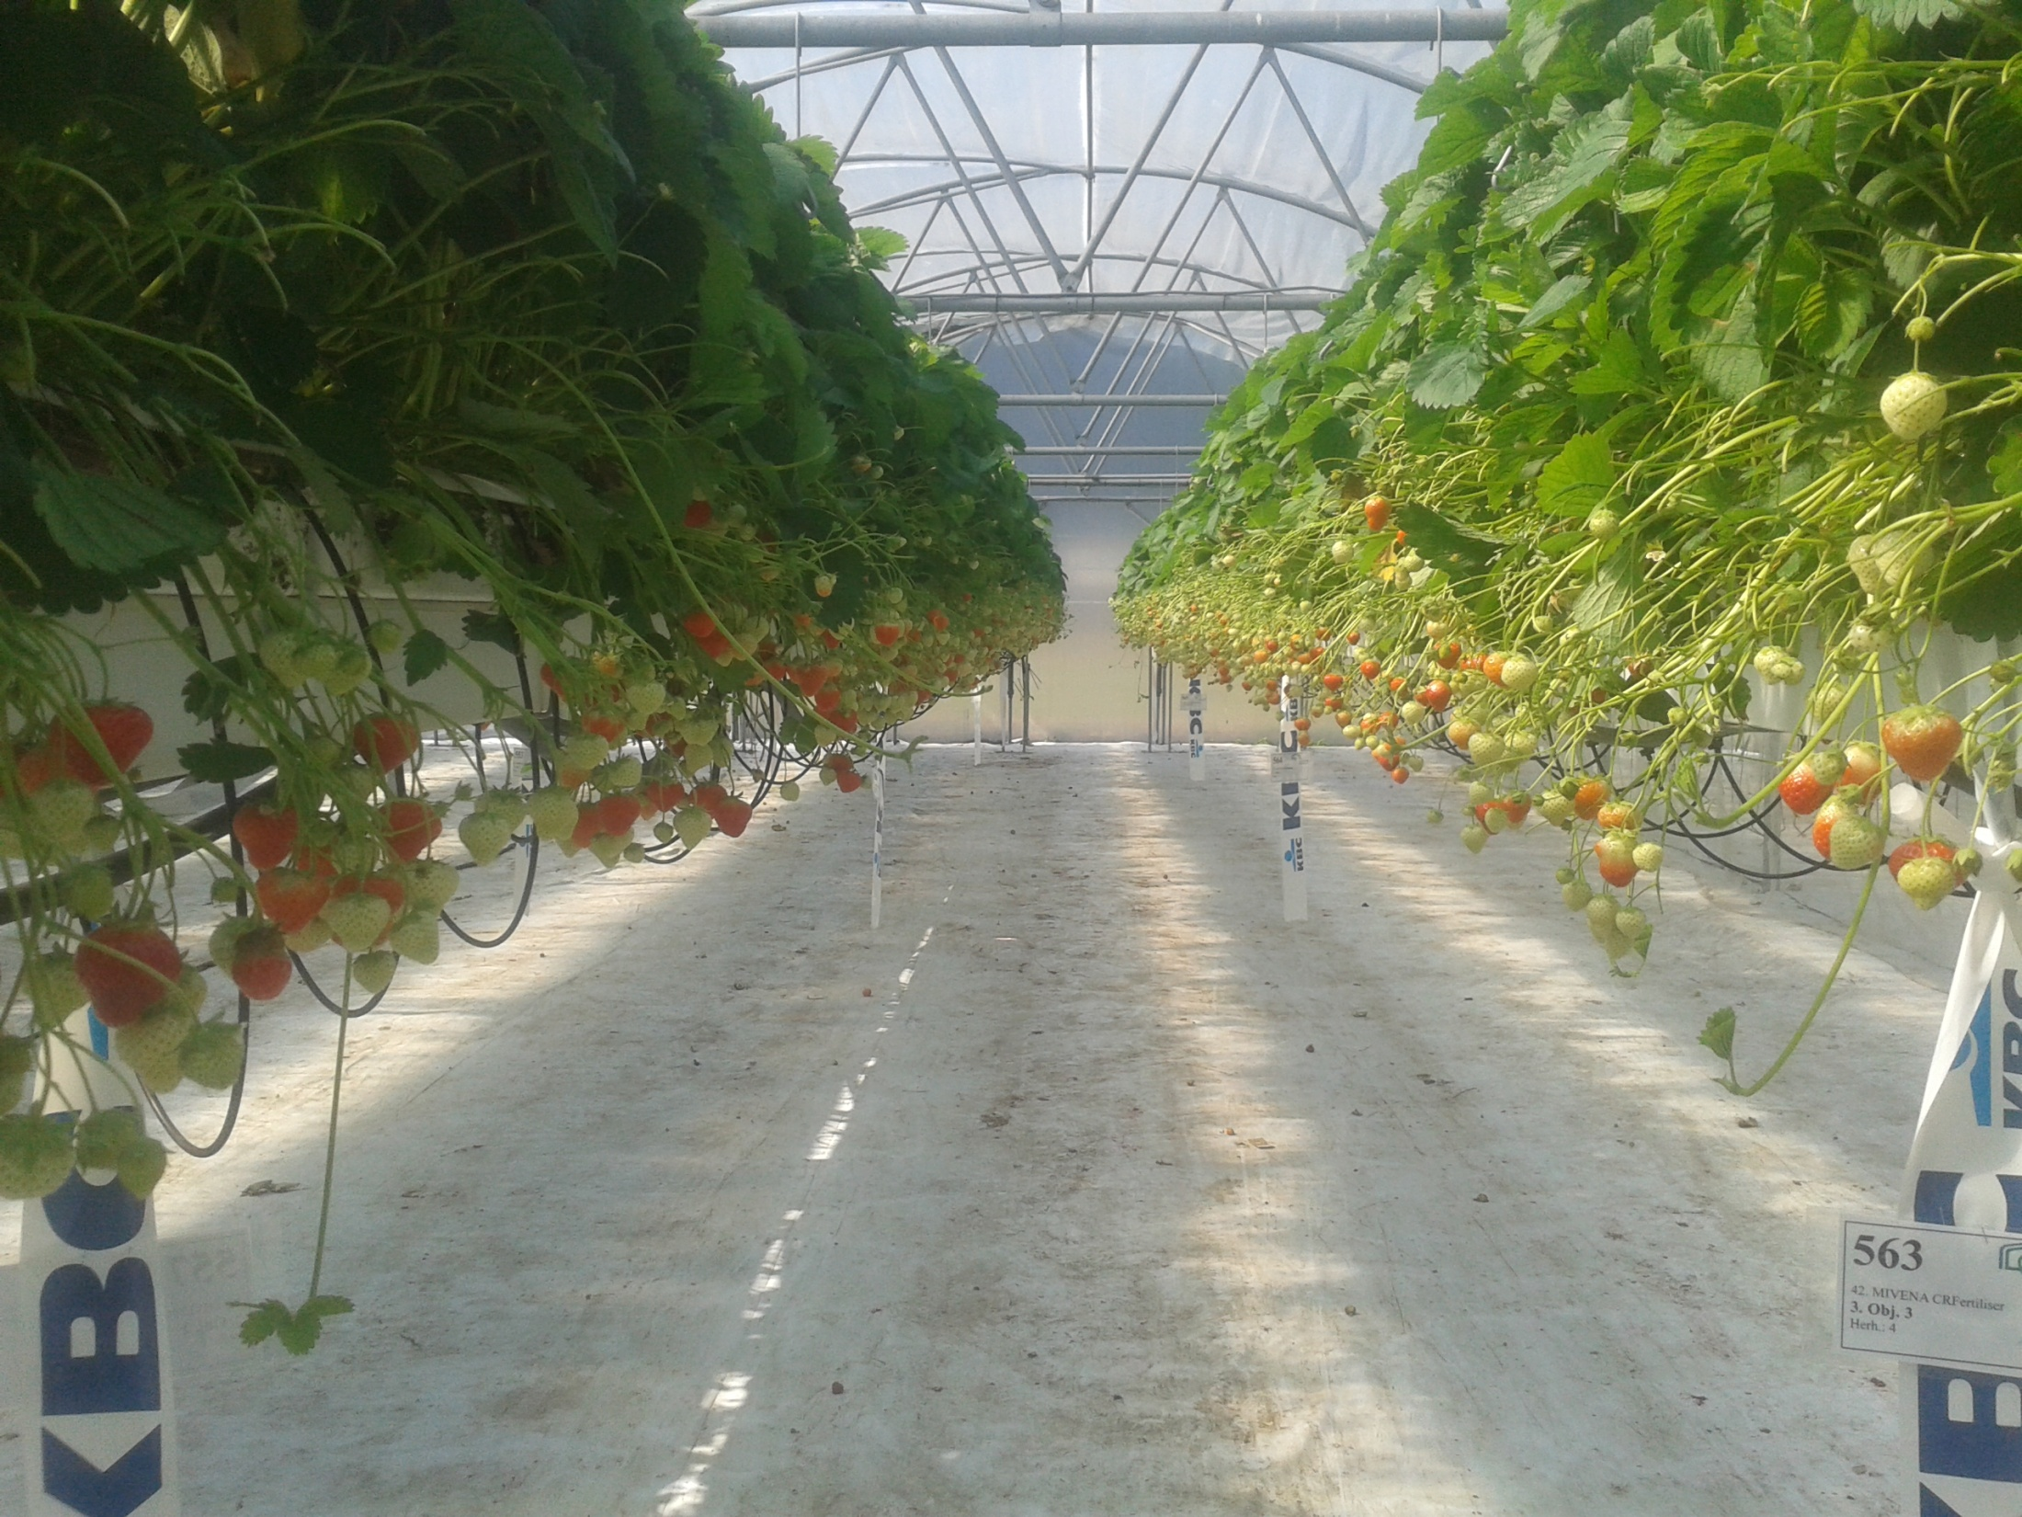

Slide 89
Strawberries in Estonia
First year planting in May
Field Cote 18+6+12+7MgO+Te 14gr plant 5-6M
Second year at Spring time
Field Cote 18+6+12+7MgO+Te 12gr plant 5-6M
Granusol at needs of the plant
Or
Field Cote 18+6+12+7MgO+Te 8gr plant 5-6M + irrigation with Granufert

Slide 90
Third year (last year)
Field-Cote 18+6+12+7MgO+Te 8gr plant 3-4M in Spring time + Granusol at plant need
or
Field-Cote 18+6+12+7MgO+Te 6gr plant 3-4M in Spring time + drip irrigation with Granufert.

Slide 91
Raspberry

Slide 92
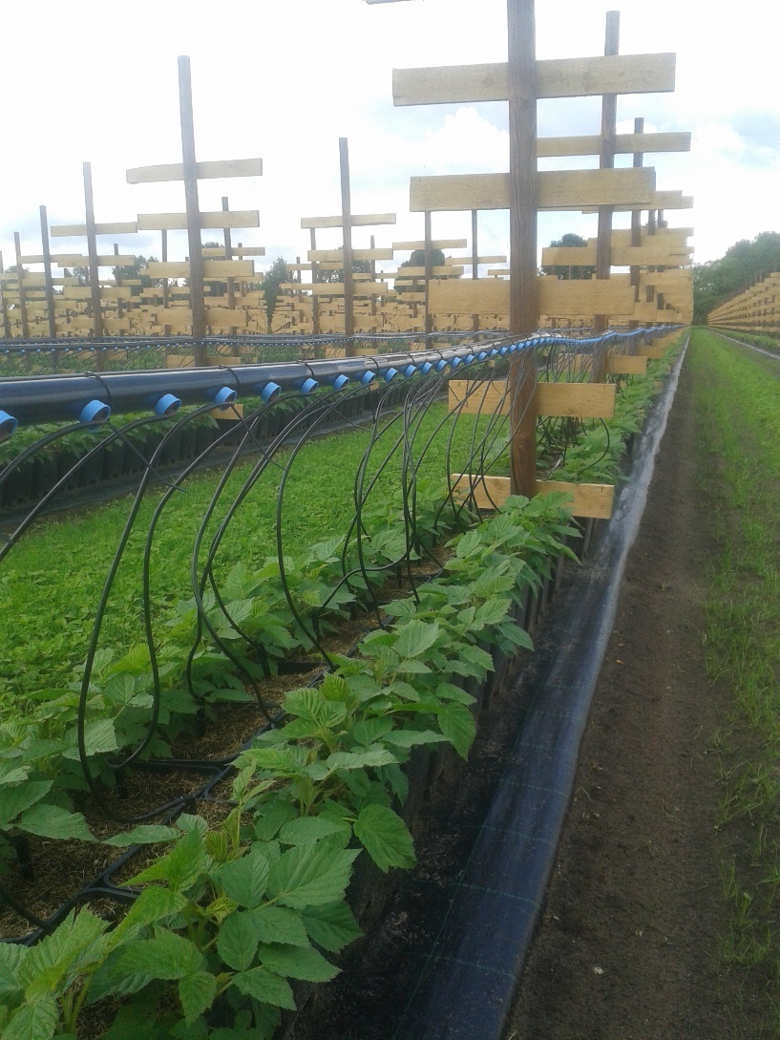
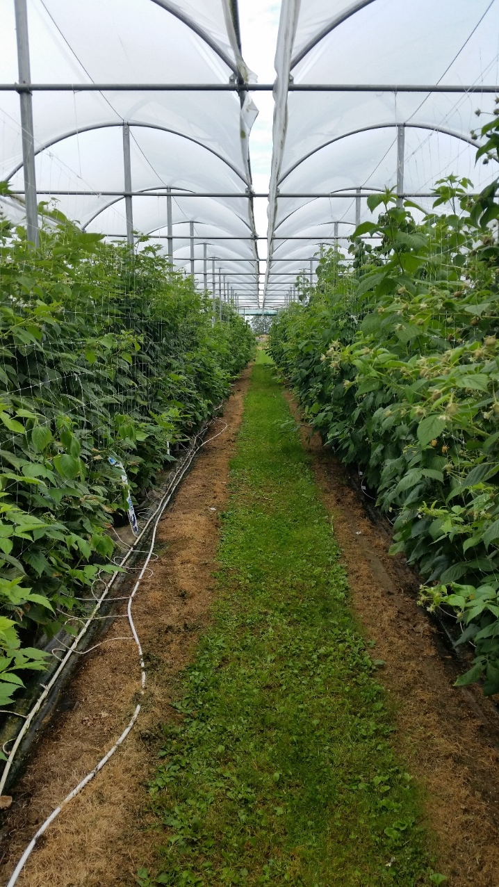
Raspberry container

Slide 93
Raspberry
Raspberry pots general fertilisation schedule 1 tank
date | product | dosage | repeat
at planting | Horti-Cote CRF 15+6+12+2MgO+Te 8M | 2-3 kg / m3 | n/a
after 3-4 weeks | Granusol WSF 15+10+14+12CaO+Te | 0,3-0,5EC over water EC | weekly
fruit setting | Granusol WSF 12+7+24+2MgO+7CaO+Te | 0,5EC over water EC | weekly

Slide 94
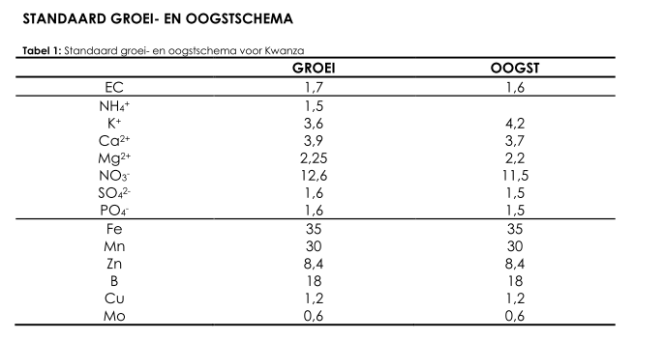
Kwanza

Slide 95
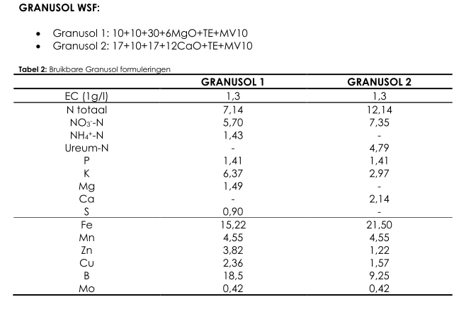

Slide 96
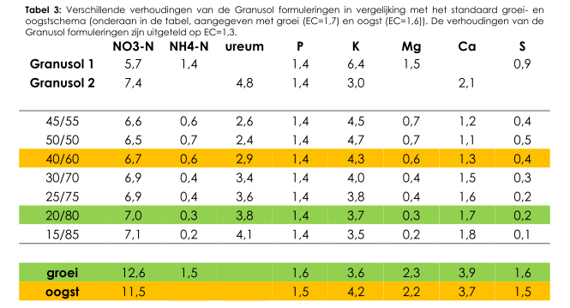

Slide 97
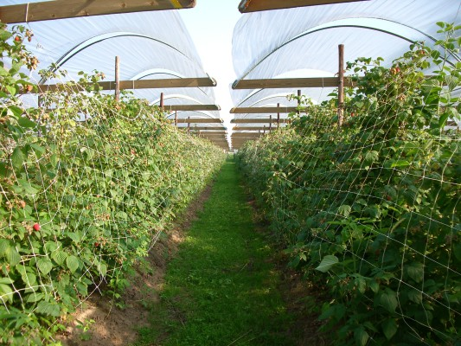
Raspberry Fieldgrown
Van Hoof-
Van den Biggelaar

Slide 98
Raspberry
Raspberry fieldgrown no fertigation
date | product | dosage | repeat | cost p/20kg bag
before planting | Horti-Cote Plus 15-6-12+2MgO+Te 8M | 50 gr / plant | n/a |  | (year 1)
spring | Field-Cote 18-8-12+7MgO+Te 8M | 70 gr / plant | n/a |  | (year 2)
flowering | Granusol WSF 17+10+17+12CaO+Te (Green) | 6 kg /ha | 2 times
fruit setting | Granusol WSF 12+7+25+2MgO+8CaO+Te (Red) | 6 kg /ha | 3 times
spring | Field-Cote 18-8-12+7MgO+Te 8M | 75 gr / plant | n/a |  | (year 3)
flowering | Granusol WSF 17+10+17+12CaO+Te (Green) | 6 kg /ha | 2 times
fruit setting | Granusol WSF 12+7+25+2MgO+8CaO+Te (Red) | 6 kg /ha | 3 times
spring | Field-Cote 18-8-12+7MgO+Te 8M | 75 gr/plant | n/a |  | (year 4 +)
flowering | Granusol WSF 17+10+17+12CaO+Te (Green) | 6 kg /ha | 2 times
fruit setting | Granusol WSF 12+7+25+2MgO+8CaO+Te (Red) | 6 kg /ha | 3 times

Slide 99

Blueberry

Slide 100

Fieldgrown Blueberry
Schrijnwerkers

Slide 101

Schrijnwerkers

Slide 102
Blueberry Fieldgrown
Foliar feeding:
Granusol 27+15+12+MgO+TE+MV10
Blueberry general fertilisation schedule
date | product | dosage | repeat
Basic | Field-Cote 20+5+20+2MgO+TE 6M | 45 grams / plant | n/a
growing | Granusol WSF 11+6+18+2MgO+Te+MV10 | 0,5EC over water EC | weekly
fruit setting | Granusol WSF 11+6+18+2MgO+Te+MV10 | 0,8 EC over water EC | weekly
 | Granusol WSF 10+10+30+6MgO+TE+MV10 | 0,8 EC over water EC | weekly

Slide 103

Blueberry Container fruit production
Douven
Blueberry

Slide 104
Blueberry container fruit production
Blueberry general fertilisation schedule
date | product | dosage | repeat
at planting | Horti-Cote CRF 16+6+11+2MgO+Te 6M | 3 kg / m3 | n/a
growing | Granusol WSF 11+6+18+2MgO+Te+MV10 | 0,5EC over water EC | weekly
fruit setting | Granusol WSF 11+6+18+2MgO+Te+MV10 | 0,8 EC over water EC | weekly
 | Granusol WSF 10+10+30+6MgO+TE+MV10 | 0,8 EC over water EC | weekly

Slide 105
Acidifying / basic effect
(g/kg CaCO3)

Slide 106

Red Currant
Berry Brothers

Slide 107
Red currants
Red Currants Fieldgrown
date | product | dosage | repeat | cost p/20kg bag
before planting | Horti-Cote Plus 15-6-12+2MgO+Te 8M | 50 gr / plant | n/a |  | (year 1)
spring | Field-Cote 18-8-12+7MgO+Te 8M | 60 gr / plant | n/a |  | (year 2)
flowering | Granusol WSF 17+10+17+12CaO+Te (Green) | 6 kg /ha | 2 times
fruit setting | Granusol WSF 12+7+25+2MgO+8CaO+Te (Red) | 6 kg /ha | 3 times
spring | Field-Cote 18-8-12+7MgO+Te 8M | 75-100gr plant | n/a |  | (year 3)
flowering | Granusol WSF 17+10+17+12CaO+Te (Green) | 6 kg /ha | 2 times
fruit setting | Granusol WSF 12+7+25+2MgO+8CaO+Te (Red) | 6 kg /ha | 3 times
spring | Field-Cote 18-8-12+7MgO+Te 8M | 75-100 gr/plant | n/a |  | (year 4 +)
flowering | Granusol WSF 17+10+17+12CaO+Te (Green) | 6 kg /ha | 2 times
fruit setting | Granusol WSF 12+7+25+2MgO+8CaO+Te (Red) | 6 kg /ha | 3 times

Slide 108

Red Currant de Tienegieter

Slide 109

Trials Berry Brothers
K – Ca – Mg levels

Slide 110
Red Current pots General fertilization schedule
date | product | dosage | repeat
April-May | Horti-Cote CRF Topdress 14+7+20+2MGO+TE 4M | 3 kg / m3 | n/a
growing | Granusol WSF 17+10+17+CaO+TE+MV10 | 0,5EC over water EC | weekly
fruit setting | Granusol WSF 12+7+25+2MgO+8CaO+TE+MV10 | 0,8 EC over water EC | weekly

Slide 111

Blackberry

Slide 112
Blackberry
Blackberry fieldgrown
date | product | dosage | repeat | cost p/20kg bag
before planting | Horti-Cote Plus 15-6-12+2MgO+Te 8M | 50 gr / plant | n/a |  | (year 1)
spring | Field-Cote 18-8-12+7MgO+Te 8M | 70 gr / plant | n/a |  | (year 2)
flowering | Granusol WSF 17+10+17+12CaO+Te (Green) | 6 kg /ha | 2 times
fruit setting | Granusol WSF 12+7+25+2MgO+8CaO+Te (Red) | 6 kg /ha | 3 times
spring | Field-Cote 18-8-12+7MgO+Te 8M | 75-100 gr / plant | n/a |  | (year 3)
flowering | Granusol WSF 17+10+17+12CaO+Te (Green) | 6 kg /ha | 2 times
fruit setting | Granusol WSF 12+7+25+2MgO+8CaO+Te (Red) | 6 kg /ha | 3 times
spring | Field-Cote 18-8-12+7MgO+Te 8M | 75-100 gr/plant | n/a |  | (year 4 +)
flowering | Granusol WSF 17+10+17+12CaO+Te (Green) | 6 kg /ha | 2 times
fruit setting | Granusol WSF 12+7+25+2MgO+8CaO+Te (Red) | 6 kg /ha | 3 times

Slide 113

Blackberry pots

Slide 114
Blackberry
Blackberry pots
date | product | dosage | repeat
at planting | Horti-Cote CRF 15+6+12+2MgO+Te 8M | 3 kg / m3 | n/a
after 3-4 weeks | Granusol WSF 12+7+24+2MgO+7CaO+Te | 0,3-0,5EC over water EC | weekly
fruit setting | Granusol WSF 15+10+14+12CaO+Te | 0,5EC over water EC | weekly

Slide 115

Black Currant
Poland

Slide 116
Black Current
Field-Cote CRF 12-5-28+2MgO+Te 8M
(in the last year 6M)
35-40 gr / plant
Additional:
Granusol Blue & Red 10 kg/ha
every 14 days

Slide 117



Cooperation with trial stations:

Slide 118
Trial locations

Slide 119
Trials Mivena
Delphy Strayberry fruitproduction
Red Currant
Delphy UK Strawberry table grown
PCH Trayplants
PCF Everbearers - Raspberry
Inhort Blue Berry - Raspberry
BICH Blue Berry
CAF Red currant
Hortinova Strawberry plant propagation
(trials will be organized for minimum 3 year)

Slide 120

Delphy strawberry fruitprodution

Slide 121

Trial centre Hoogstraten table grown

Slide 122

Red Current Trial CAF

Slide 123
Trials Berry Brothers

Slide 124
Red Currant de Tienegieter

Slide 125

PCF Sint Truiden
Kwanza fertigation schedules

Slide 126

BICH trial centre Horst

Slide 127


Slide 128


Slide 129
Stefan Hoefnagel

