Slide 1
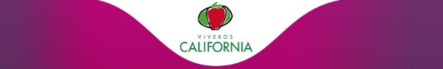
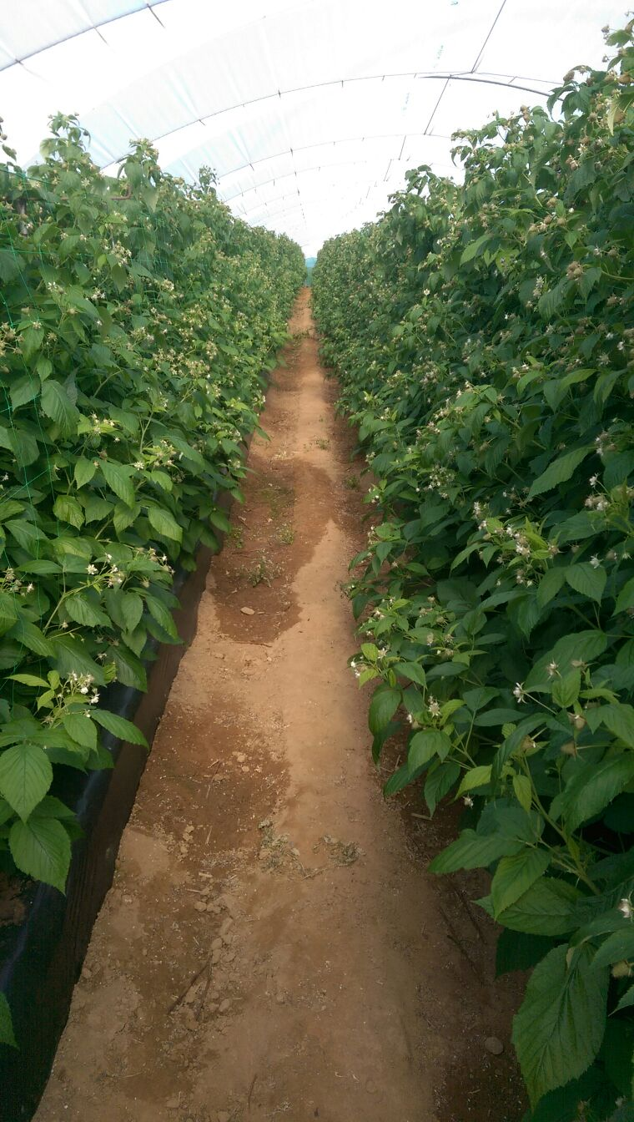
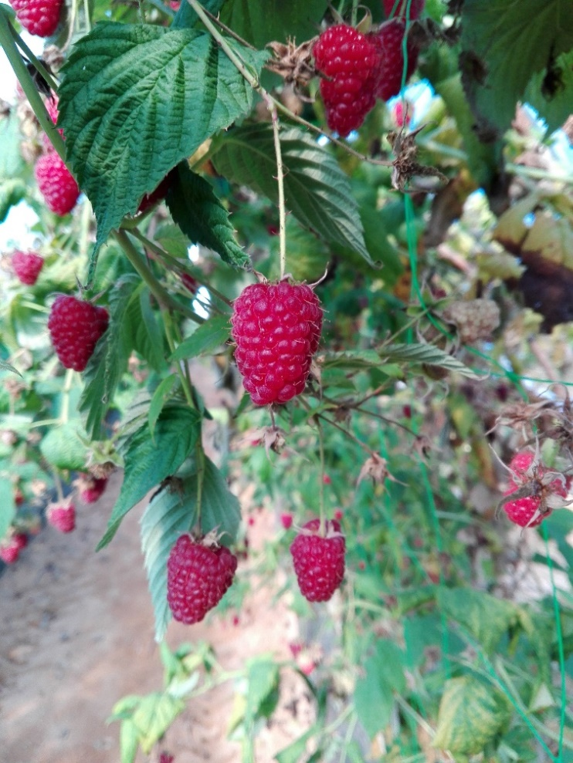

Slide 2
Different types of raspberry
  Primocane: They can produce two crops in the same year: one at the end of summer (mid-August to late September) on the upper third of the branch that has grown during that season,and another, in the following spring-summer, in the rest of the branch that did not fructify the previous year. In the same year, a new outbreak will start, completing the cycles.
  .Floricane: They produce a single crop a year, during the summer season, on the branches grown past year; that is, one year the branches grow and the next they bear fruit and dry, behaving in this way as biannual stems.

Slide 3
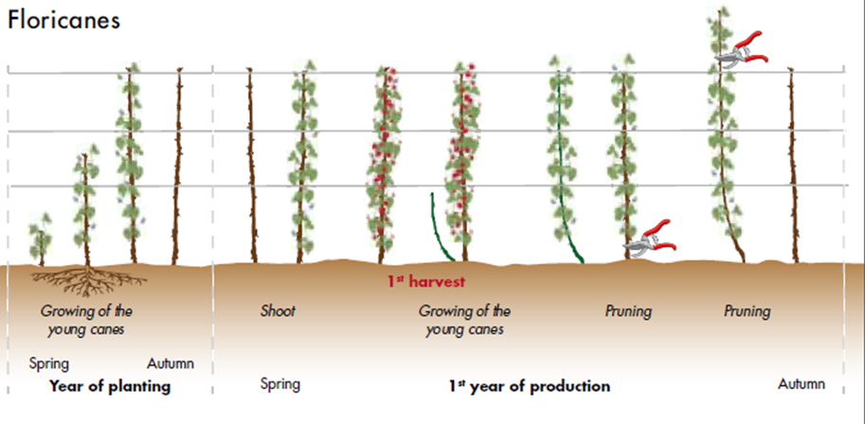

Slide 4
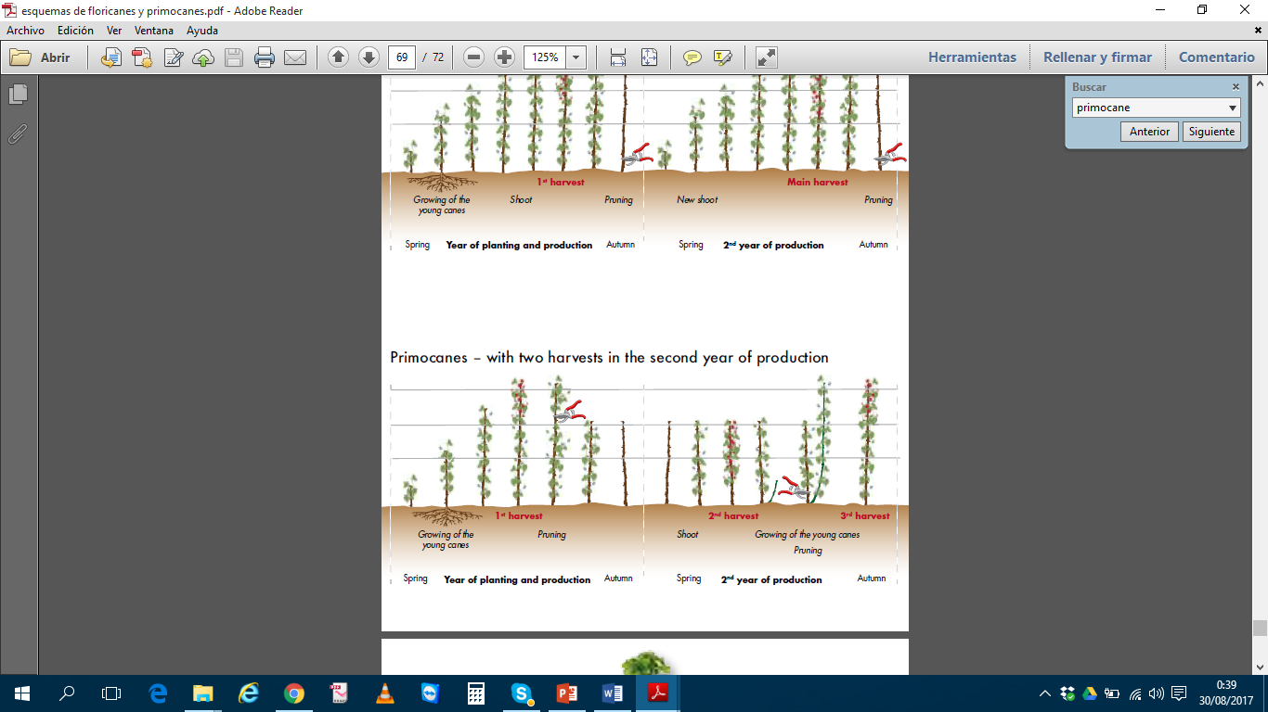
Primocanes

Slide 5
San Rafael
The variety is classified as floricane, to bear fruit in the second year wood. Hight necessity of chilling hours. 1000 hours under 7ºC
In Spain and other warm countries, is a variety of winter production, comparable with Tulamen, Glen Fyne and Lagoray
The fruit quality is excellent. The fruits have a delicate balance between sweetness and acidity throughout the entire crop with average values of 9.85 Brix.
The standard height of the cane is from 1.70 to 2m. The plants are upright, vigorous and vegetative.

Slide 6
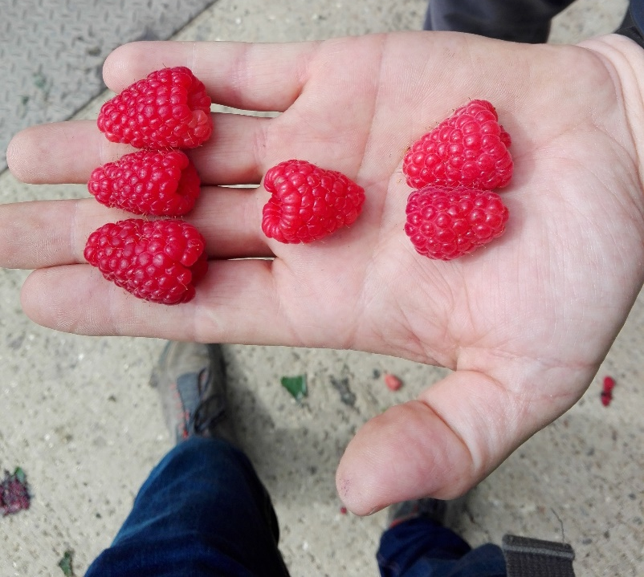
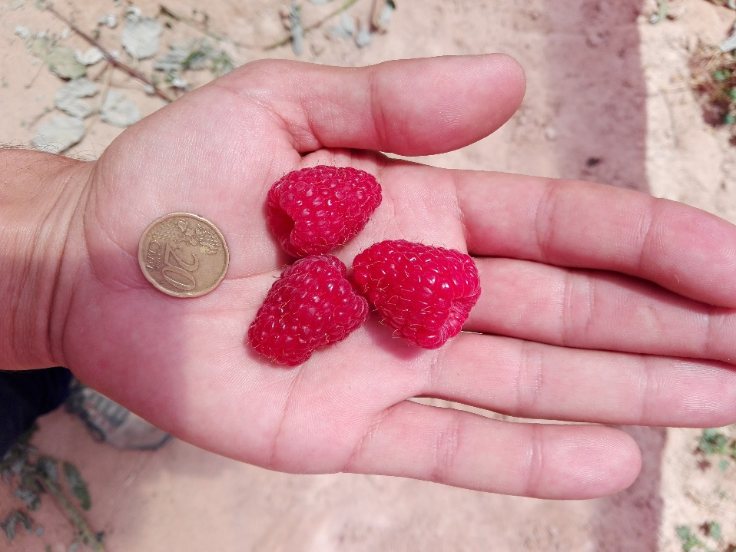
‘
San Rafael
The fruit is large, with an average weight of 5 grams, Is between 3 and 3.5cm long, 2-2.5 cm wide, presenting a conical elongated.
The size and shape of fruit is very similar to Tulameen, Glen Fyne and Lagoray.
San Rafael
Tulamen
San Rafael
Glen Fyne

Slide 7
San Rafael
The fruit shows excellent shelf life, presenting a high strength without bleeding or presence of mold after being conservarda 48h and 72h
2-4 ° C to 25 ° C.
Marketing is aimed at fresh fruit market due to the high quality that presents this variety.
Plants have shown resistance to Botrytis cinerea, Phytophthora cactorum and Sphaerotheca humuli under greenhouse conditions

Slide 8
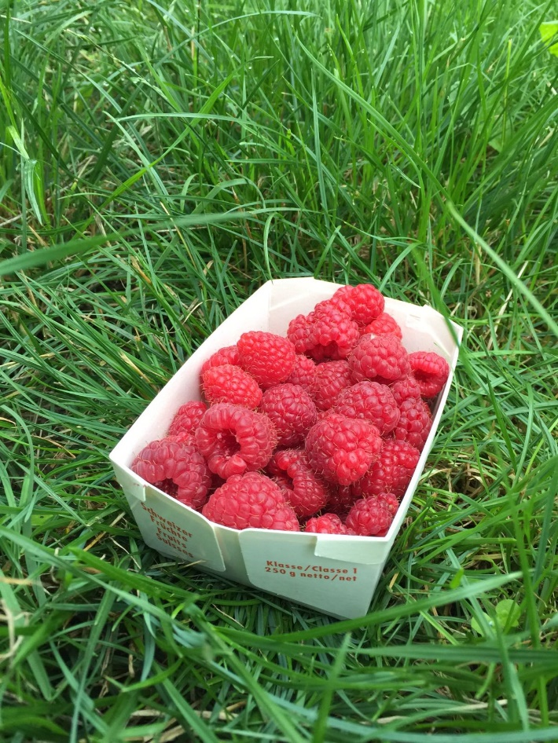
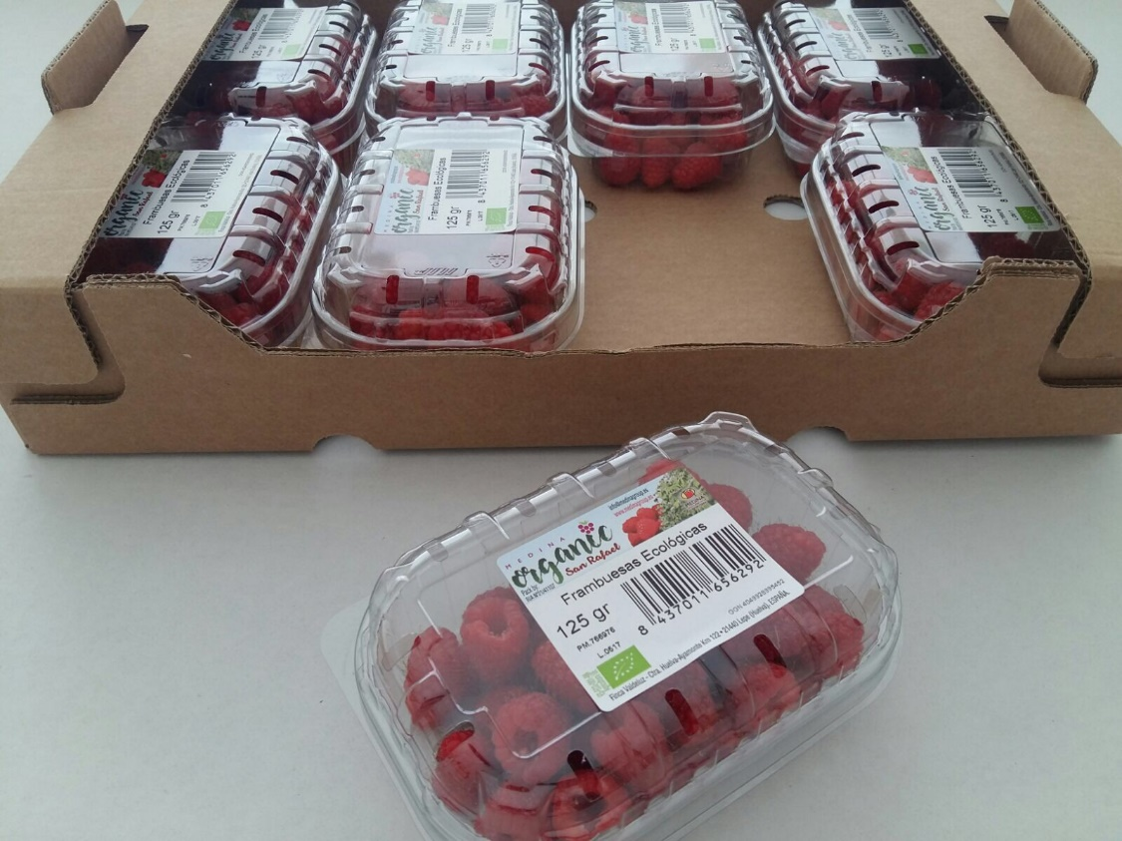
San Rafael – BIO Management
Excellent with organic crop management

Slide 9
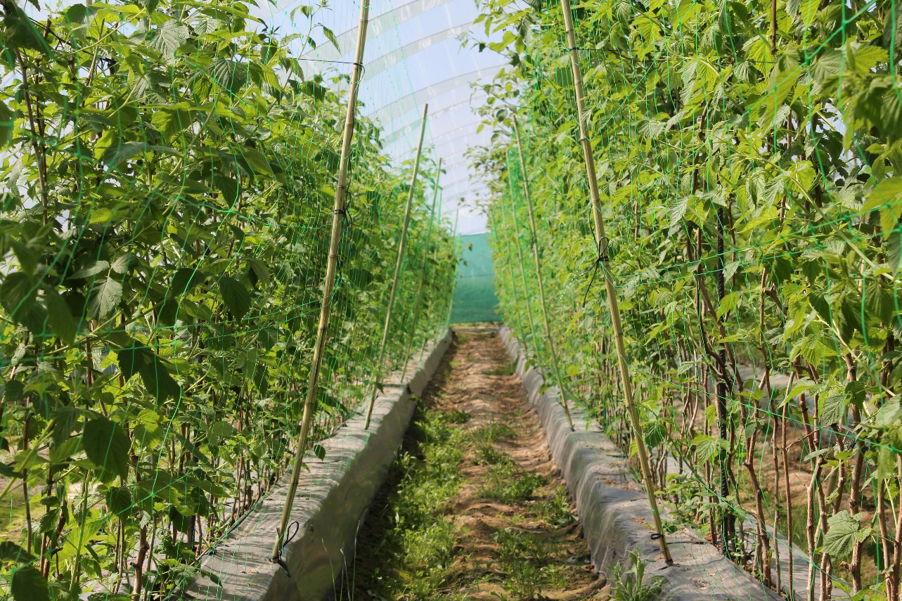
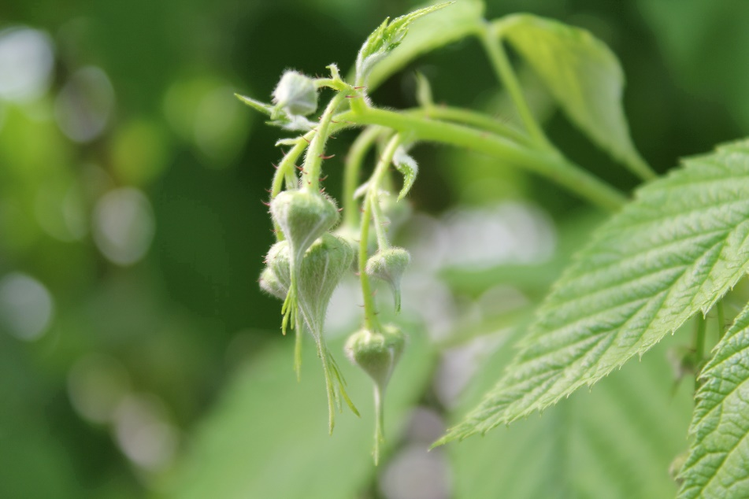
‘San Rafael’ – BIO management

Slide 10
‘San Rafael’
CHOOSING THE RIGHT TYPES OF PLANTS
The demands of the trade on the quality of raspberries are rising. In order to meet these demands it is important to choose the right variety but also the right method of production.
Shorter cultivation periods, a more
intensive raspberry cultivation as well as the farming of raspberries in substrate lead to a better and more even fruit quality.
In view of the more intensive production, it is necessary that the plant
propagator can offer the right plants.

Slide 11
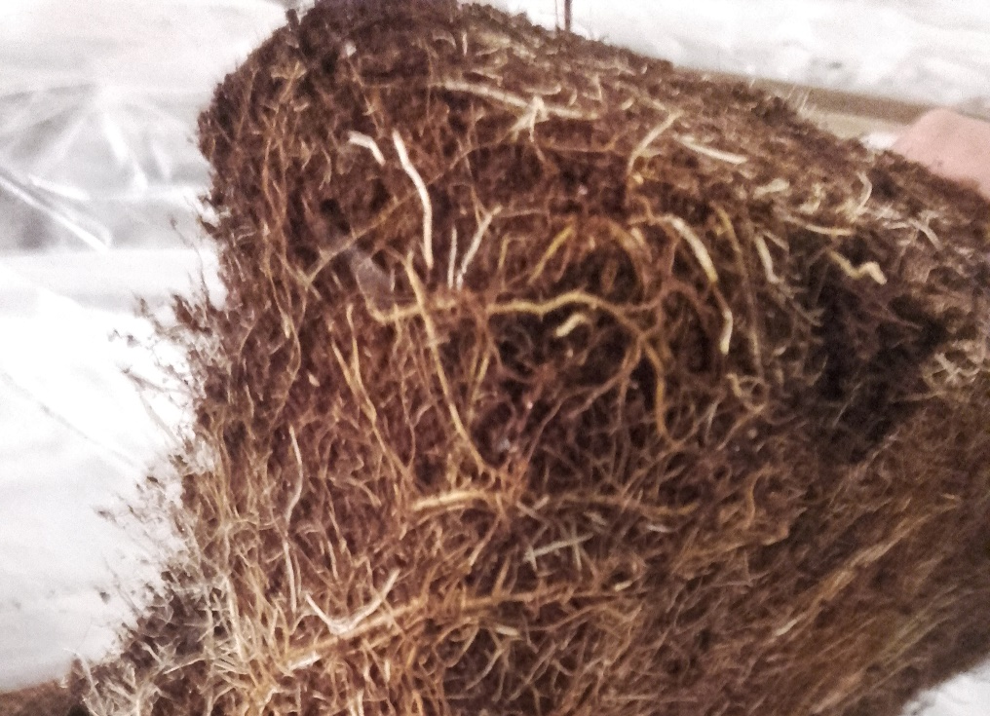
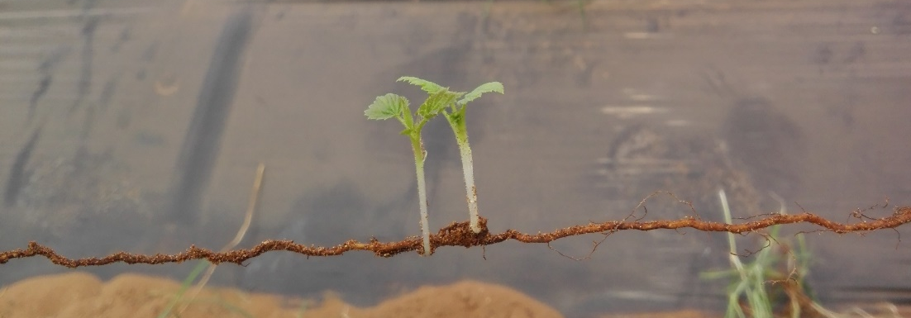
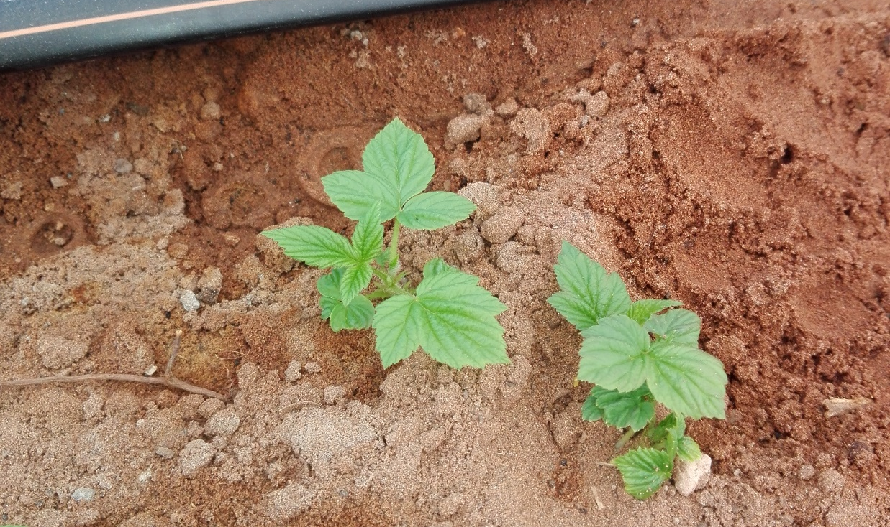
ROOTS
Root for planting in April

Slide 12
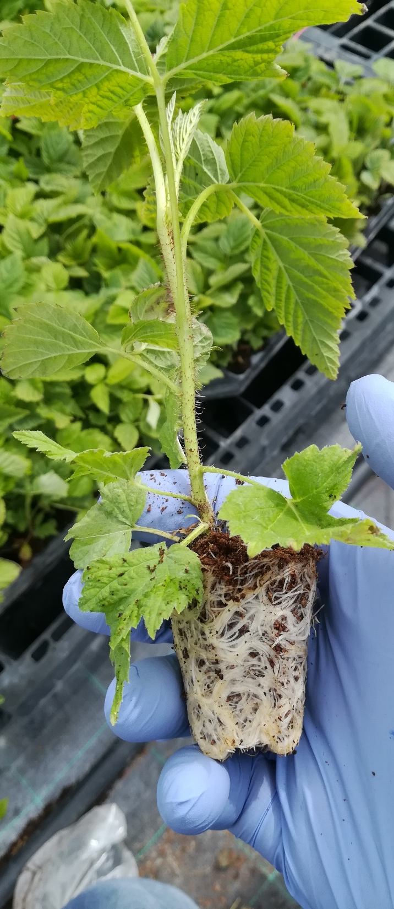
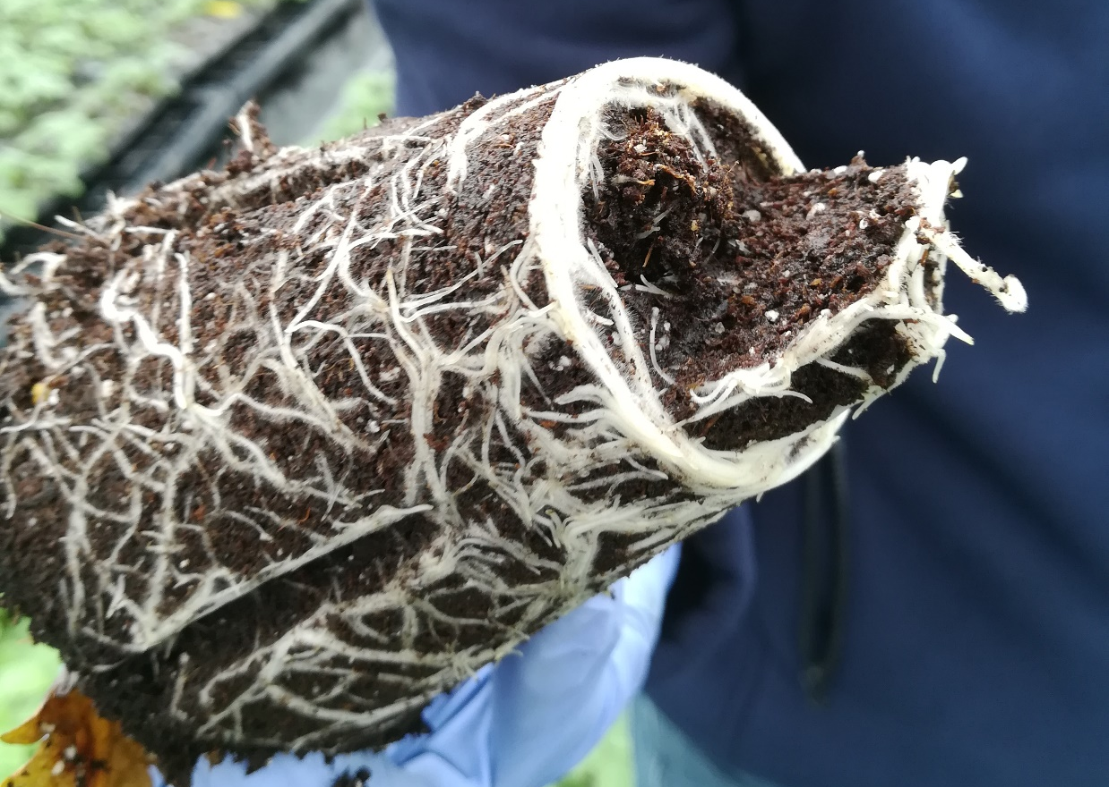
POTTED FRESH PLANTS.
Root cuttings, for planting in middle of may

Slide 13
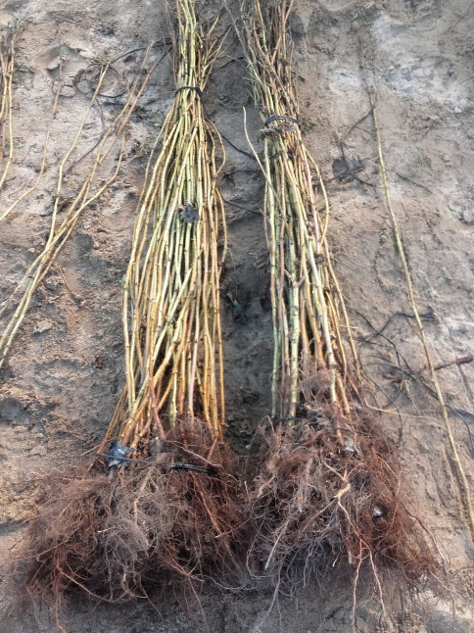
BARE ROOTS CANES or BARE ROOTS FRIGO CANES
One year old, for planting in early Spring

Slide 14
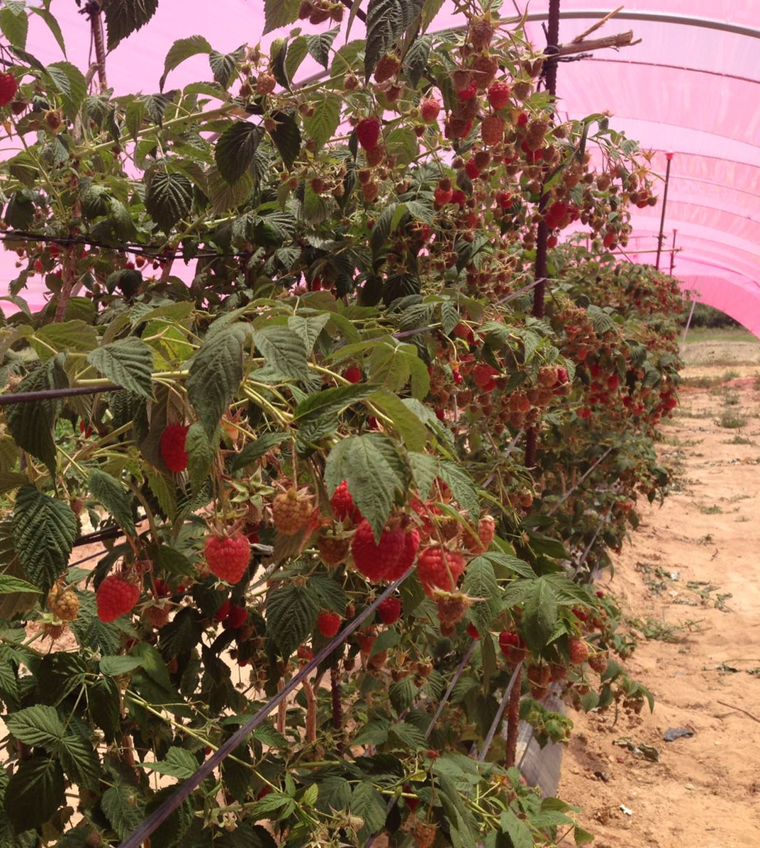

Slide 15
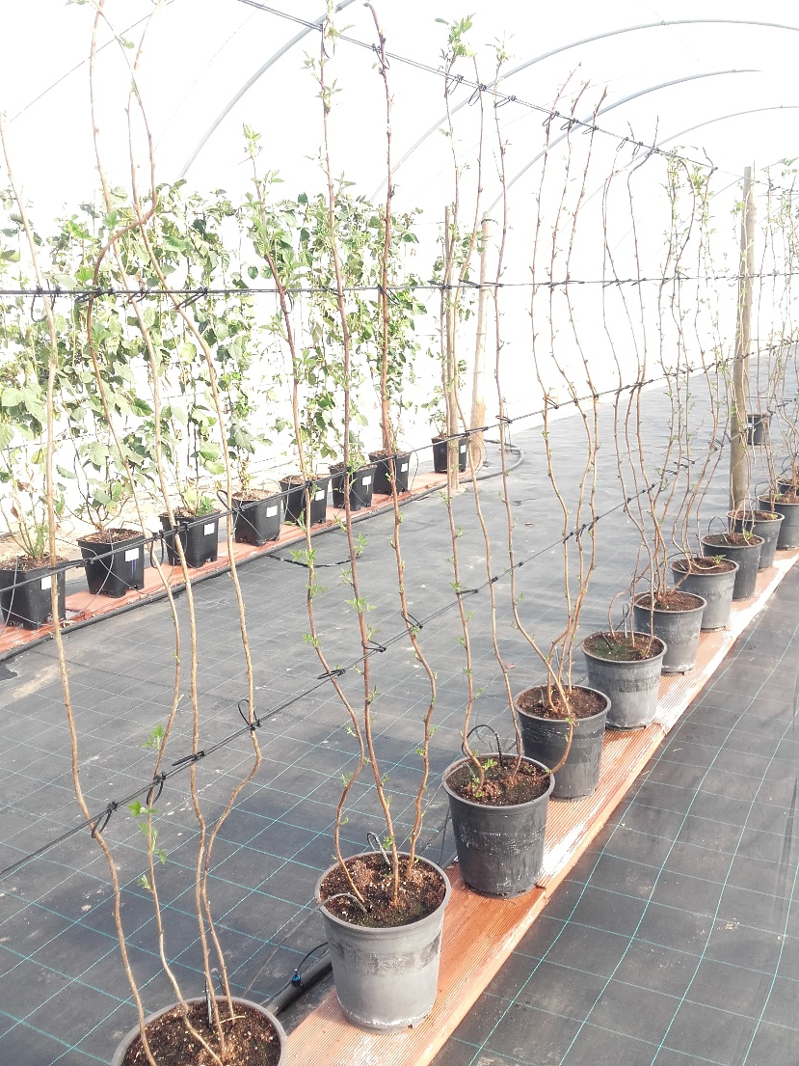
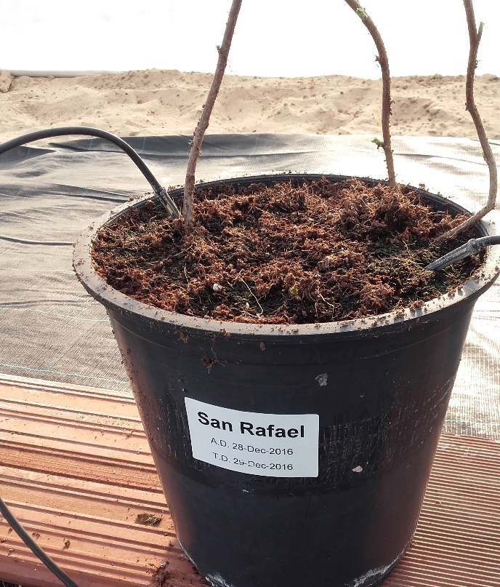
POTTED PLANTS FRIGO CANES.
One year old, for planting in early spring.
Precocity. 20 days earlier
Higher yield

Slide 16
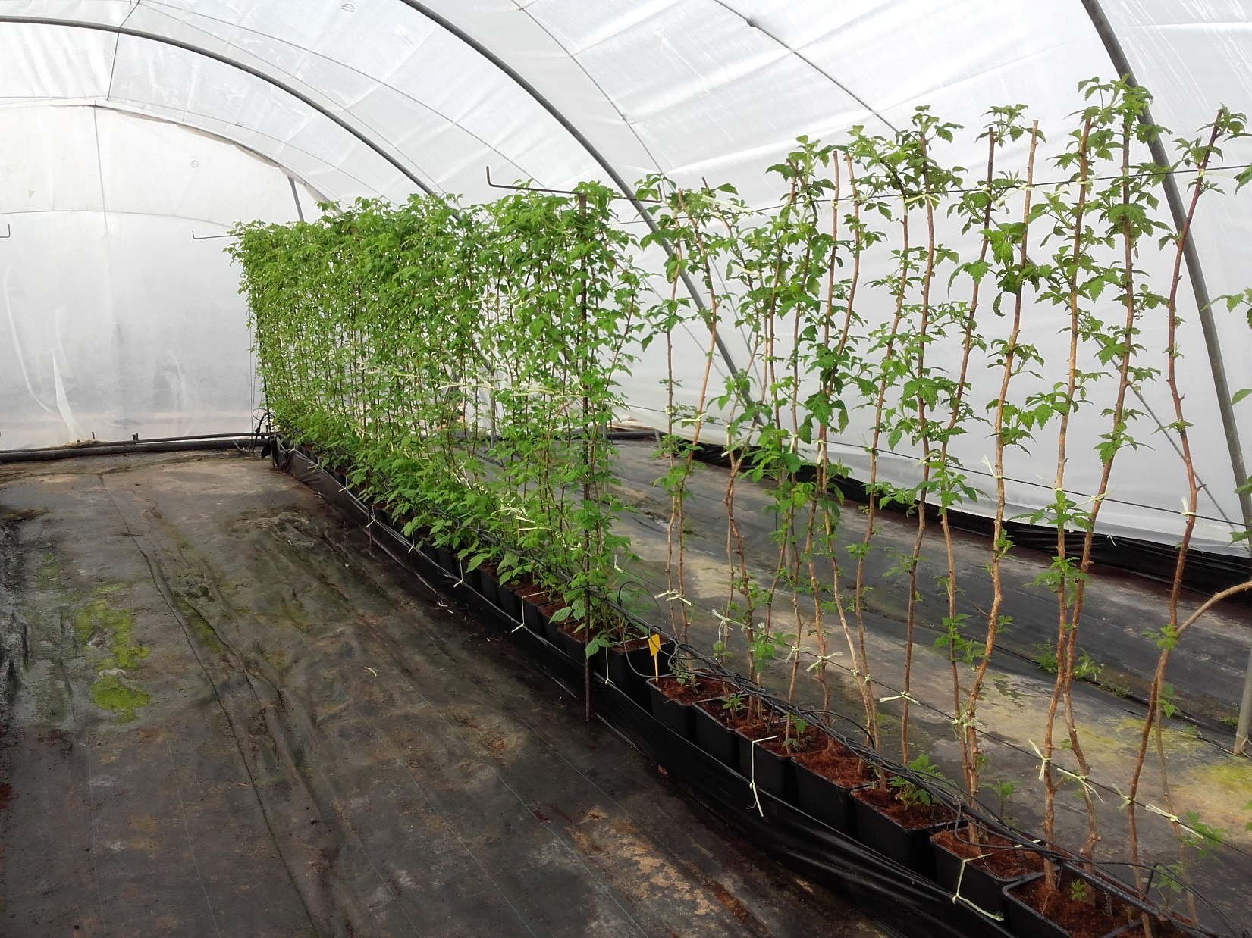
POTTED PLANTS CANES vs BARE ROOT PLANTS

Slide 17
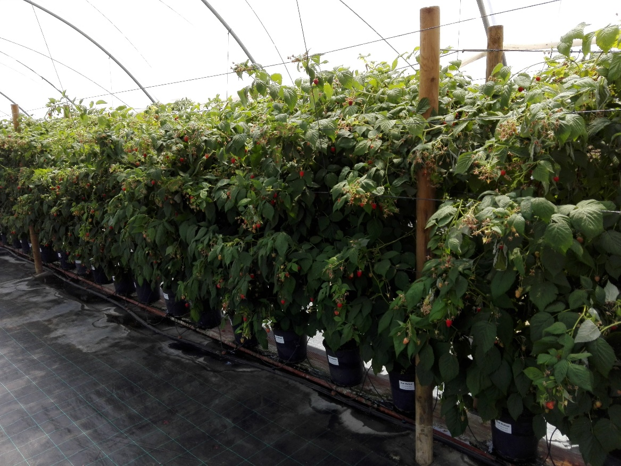
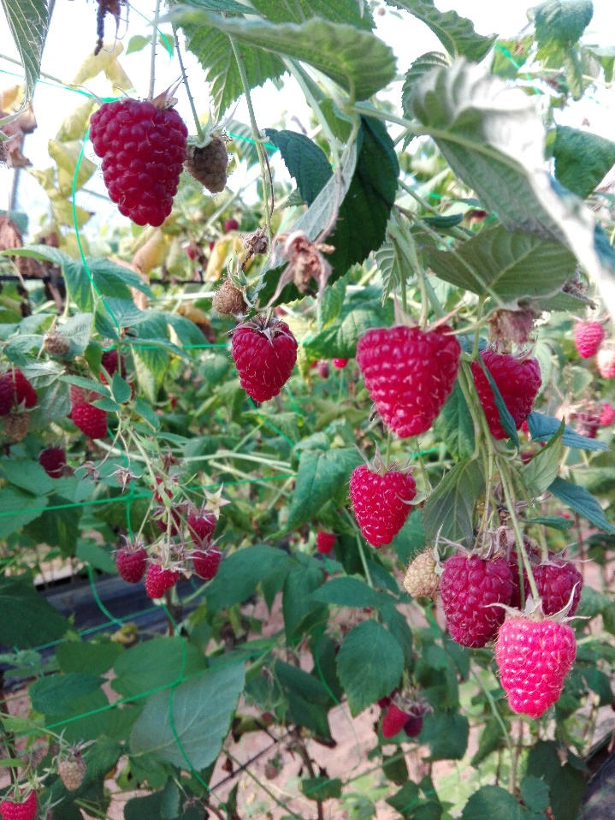
‘San Rafael’ – FLORICANE
The yields obtained in the last years have been more than 800g / plant in Bare Root Canes and 1000 g / plant in Plant in Potted Cane

Slide 18


Slide 19
LONG CANE MACETA DICIEMBRE.
Precocidad
From the last campaign, the following information was extracted.
- 1 hectare
- 3200 linear meters.
- 2 pots per meter - 6400 pots / ha / 3 canes / pot
- 19200 plants / ha.

Slide 20
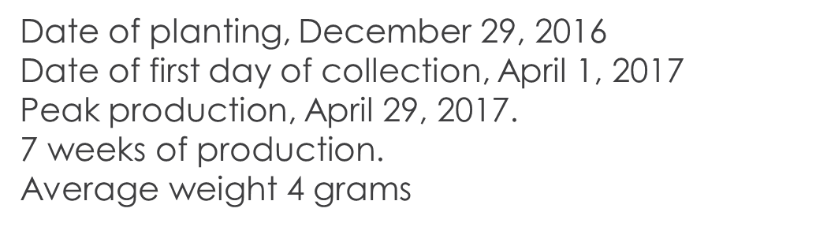
Total production. 24,000 kilos / ha
- 1.25 kilos / plant
Destrío 21%
4% small fruit.
5% crumbly.
11% overdrive. (Collected every 2 days)
1% others.
- Commercial production. 18,960 kilos / ha
- 1 kilo / plant

Slide 21
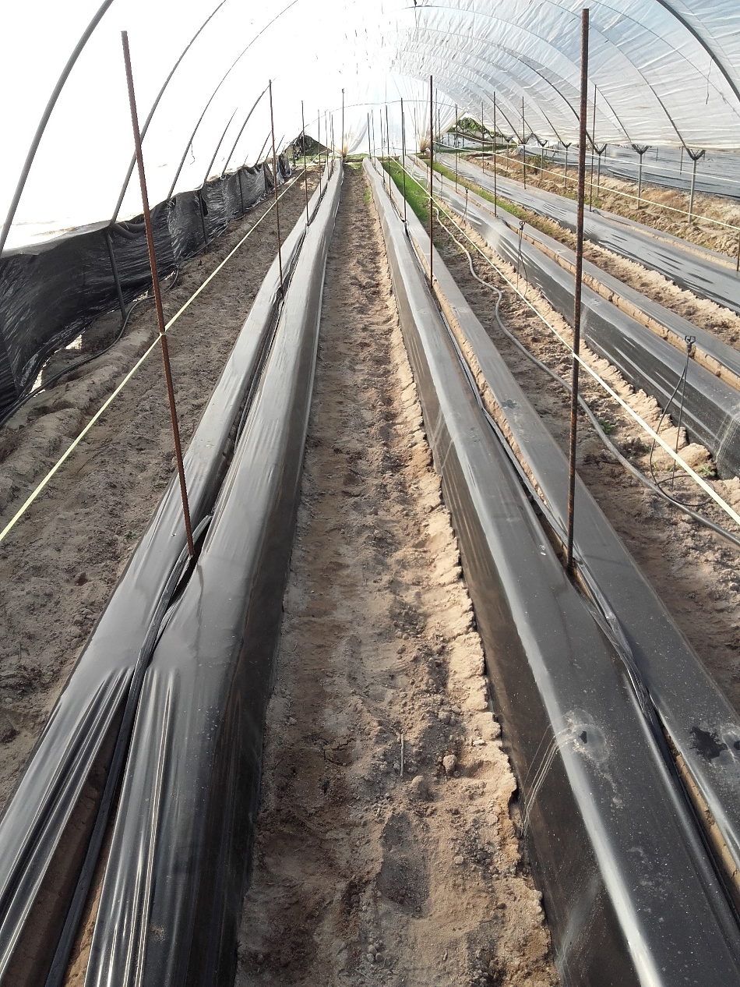
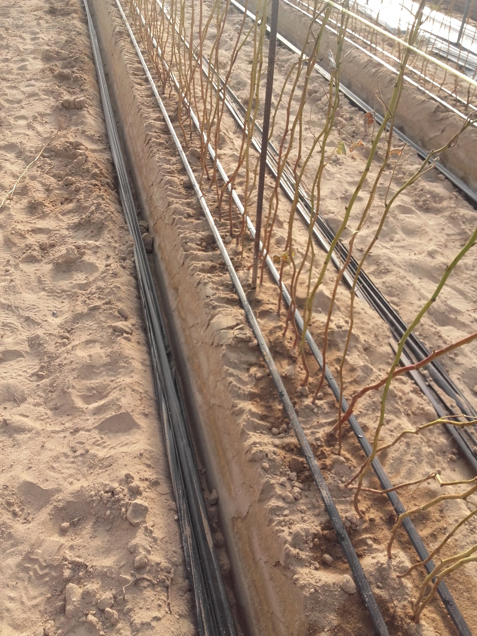
SAN RAFAEL.

Slide 22
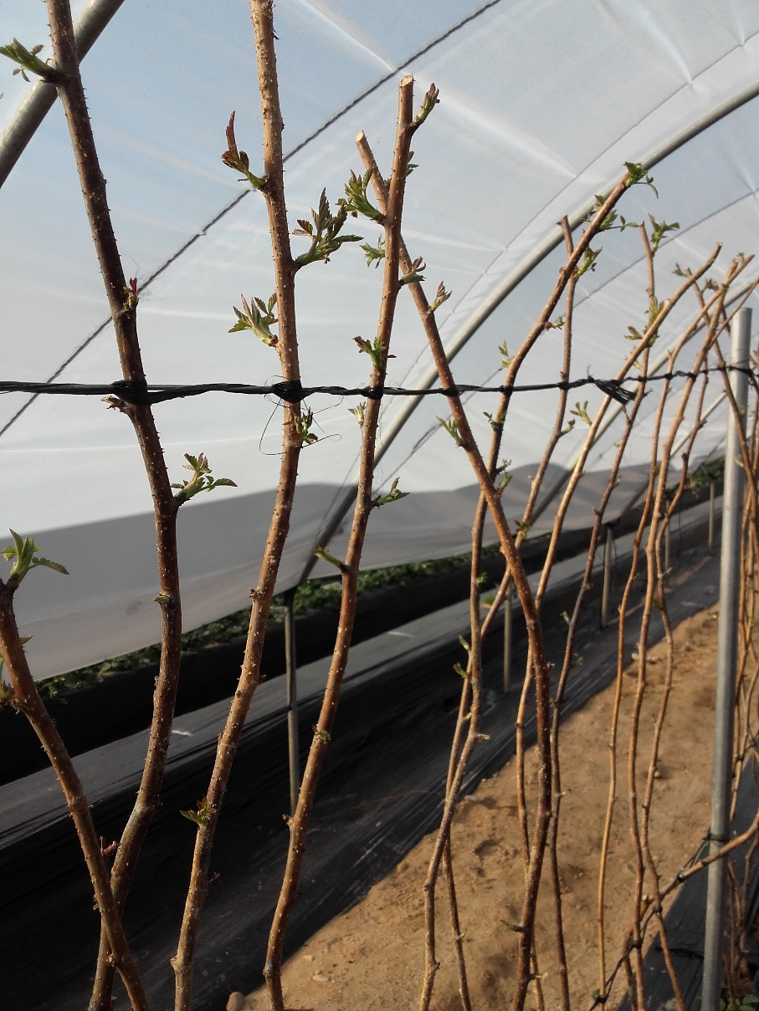
SAN RAFAEL.

Slide 23
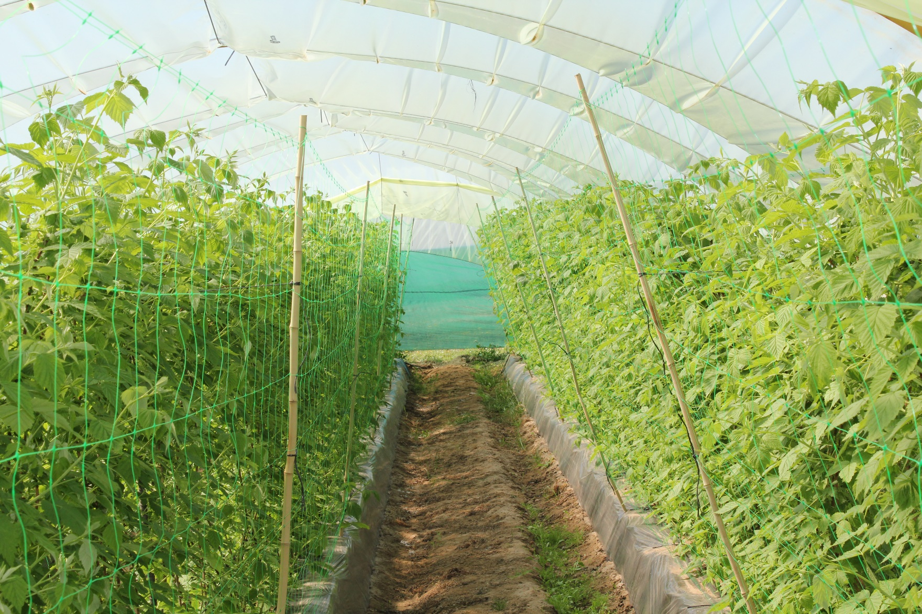
SAN RAFAEL.

Slide 24
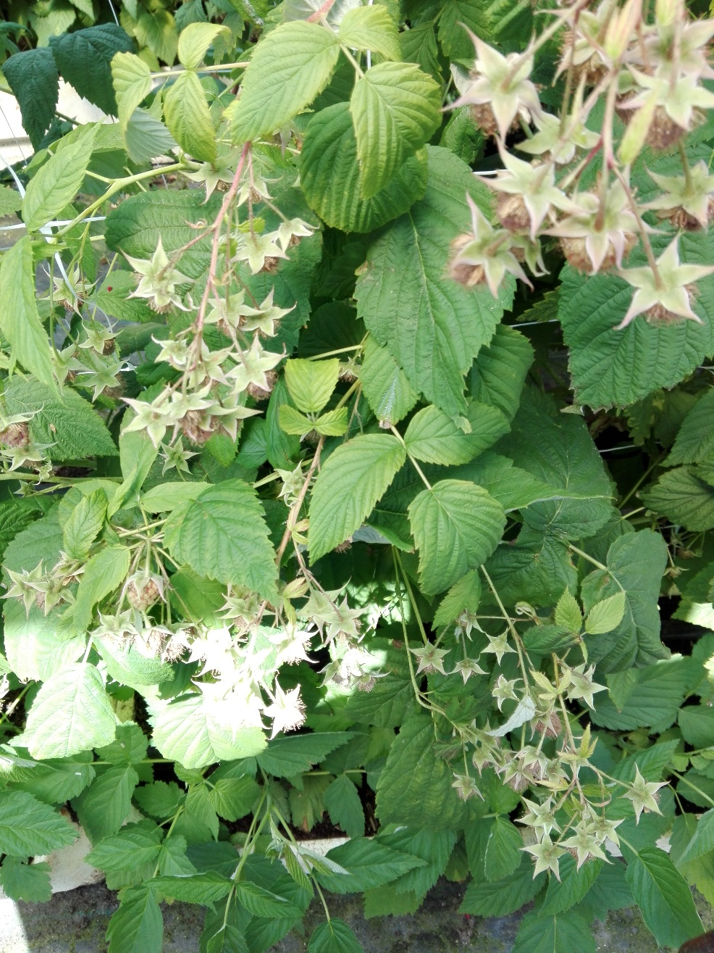
SAN RAFAEL. FLORACIÓN.

Slide 25

SAN RAFAEL.

Slide 26
Thank you
Javier Marrufo Sández
Development Manager

